Slide 1
Tapping into ARP
State and Local Fiscal Recovery Funds to Support
Afterschool and Summer Learning
Afterschool Alliance
National League of Cities

Slide 2
Agenda
Introduction, Goals, and Framing our Discussion
Using State Fiscal Recovery Funds for Summer Learning in Minnesota
City and Town Fiscal Recovery Funds for Afterschool and Summer Learning
Using City Fiscal Recovery Funds for Youth Programs in St. Louis
County Fiscal Recovery Funds for Afterschool and Summer Learning
Questions and Answers

Slide 3
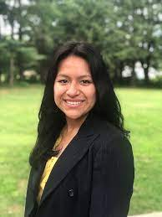
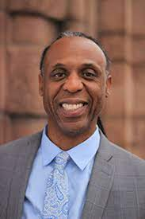
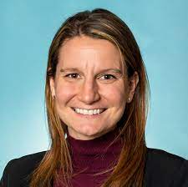
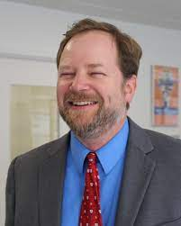
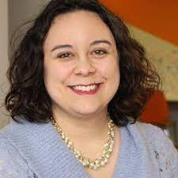
Speakers
Kari Denissen Cunnien
Executive Director,
Ignite Afterschool
Gislene Tasayco Senior Associate, National League of Cities
Wil Pinkney Jr. Director of Children, Youth, & Families, Mayor's Office of St. Louis
Rachel Mackey
Associate Legislative Director,
National Association of Counties
Erik Peterson
Senior Vice President,
Afterschool Alliance
Speaker Bios and Presentation Slides can be found on webinar registration page (see link in chat or www.afterschoolalliance.org/webinars
Notes:
Bios:
Kari Denissen Cunnien: https://igniteafterschool.org/staff-board
Rachel Mackey: https://www.naco.org/about/staff/rachel-merker
Erik Peterson: http://www.afterschoolalliance.org/aboutUsPeople.cfm#staff_modal
Wil Pinkney Jr. https://www.stlouis-mo.gov/government/departments/mayor/profiles/wilford-pinkney-jr.cfm
Gislene Tasayco: https://www.nlc.org/people/gislene-tasayco/

Slide 4
American Rescue Plan:
Opportunities for Afterschool & Summer Program Support
Education funding – Elementary and Secondary School Emergency Relief (ESSER) III Fund
•$12 billion available from state education agencies (SEAs) with 7% for learning recovery, afterschool, summer
•$122 billion provided to local education agencies (LEAs) with 20% for learning recovery strategies, including afterschool and summer enrichment
Child Care funding
•$39 billion for child care, which can include school-age care, which will flow to state child care agencies
AmeriCorps funding
•$1 billion for Corporation for National and Community Service through AmeriCorps for AmeriCorps positions to help address learning recovery and other purposes
Discretionary state & local government funding
•$350 billion for state and local governments that can be used in part for child care and other purposes; under previous COVID relief funding, some counties funded afterschool or summer programs
Notes:
American Rescue Plan for Afterschool and Summer: http://www.afterschoolalliance.org/covid/American-Rescue-Plan.cfm

Slide 5
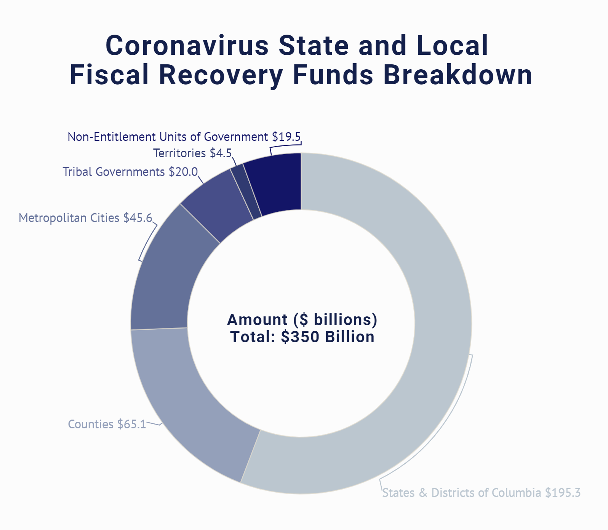
State and Local Fiscal Recovery Funds
Funding Objectives from US Dept. of Treasury:
Support urgent COVID-19 response efforts to continue to decrease spread of the virus and bring the pandemic under control
Replace lost revenue for eligible state, local, territorial, and Tribal governments to strengthen support for vital public services and help retain jobs
Support immediate economic stabilization for households and businesses
Address systemic public health and economic challenges that have contributed to the unequal impact of the pandemic
Includes:
“Evidence-based educational services and practices to address the academic needs of students, including tutoring, summer, afterschool, and other extended learning and enrichment programs”
Notes:
Treasury Interim Guidance https://home.treasury.gov/system/files/136/FRF-Interim-Final-Rule.pdf
Allocation for States (PDF) / Allocation for States (CSV)
Allocation for Non-Entitlement Units (Aggregate State Totals) (PDF) / Allocation for Non-Entitlement Units (Aggregate State Totals) (CSV)
Allocation for Territories (PDF) / Allocation for Territories (CSV)
Allocation for Counties (PDF) / Allocation for Counties (CSV)
Allocation for Metropolitan Cities (PDF) / Allocation for Metropolitan Cities (CSV)

Slide 6
Using State Fiscal Recovery Funds for Summer Learning in Minnesota
Kari Denissen Cunnien
Executive Director
Ignite Afterschool

Slide 7
Due North Minnesota’s Education Plan
Meet the Needs of Students During the COVID-19 Pandemic
Expand academic opportunities and mental health services to support every student in the summer of 2021 and through the following school year
Every Student Receives a World-Class Education
Expand access to out-of-school opportunities
Every Student Learns in a Safe and Nurturing Environment
Strengthen community and school partnerships to meet the needs of the whole child
Fund a 21st Century Education
Prioritize school funding to the students that need it the most.
https://igniteafterschool.org
Notes:
To set the stage for Minnesota’s $75M investment in education using the ARP State Fiscal Recovery Fund, it is important to understand Minnesota Governor’s Tim Walz’s Education Plan, Due North. The Due North plan was released in 2020 and provides a framework for education related goals and priorities of the Walz administration which includes the Commissioner of Education. This plan is centered around 7 key priority areas with a set of goals associated with each. For today’s conversation, there are 4 priority areas with corresponding goals that most relate. (Due North can be accessed here: https://education.mn.gov/MDE/about/plan/)

Slide 8
Setting the Stage
Previous ESSER/GEER Investments
$57.5M available to school districts for summer learning programs
Designed as $4/hr/student seat time reimbursement
Notes:
-The Governor’s use of State Fiscal Recovery Funds are designed to complement previous ESSER and GEER funds allocated to support summer learning
-This $57.5M was designed to align with another Minnesota based funding source and is based on a per pupil seat time reimbursement

Slide 9
Investing in Education & Summer
$75M total education investment
$36.614M Academic (summer learning) & mental health supports
$3.25M Expand access to tutoring
Approx. $30M for other education expenditures (Preschool for 4 and 5 year olds, Adult Basic Education, Office of Higher Education college readiness summer programs)

Slide 10
How it works – Fund Design
All school districts, including charters, can receive of portion of the $34.6M
Allocation based on the districts Average Daily Membership (ADM) and population of historically underserved students
Districts must identify use of funds in at least one of the following four areas:
Expand mental health and well-being supports during summer learning programs
Partner with community businesses and organizations for mentoring, tutoring, enrichment, transportation and meals
Bring school-based summer programs into the community
Provide students with summer field trips for hands-on learning opportunities
Notes:
The state recognizes that, to meet some of the goals of high quality summer learning design, such as community partnerships, districts would benefit from having a source of funding based on ADM (where they know what they have going in) to complement the per pupil per seat team reimbursement approach. All districts and charter schools have access and the amount for each districts varies by ADM and by their population of historically underserved students. You can also see how the 4 allowable ways this funding can be used tie back to many of the priorities in the Governor’s Due North education plan. The state also recognizes that this is an opportunity to build district capacity to build high quality community partnerships that expand opportunity for young people. Some districts excel in this area and are exemplars we can lift up. But, as this allows a statewide focus, also recognition this is a capacity building opportunity for some districts. MDE has plans/hopes to build out support to districts on high quality summer learning design, high quality community partnerships. This summer many districts are focusing on expanding mental health. The goal is that with more support for next summer, districts will expand use of funds to deepen and expand partnerships.

Slide 11
City and Town Fiscal Recovery Funds for Afterschool and Summer Learning
Placeholder for Gislene

Slide 13
Notes:
NEUs - non entitlement units

Slide 21
Using City Fiscal Recovery Funds to Support Youth in St. Louis
Wil Pinkney Jr.
Director of Children, Youth, & Families
Mayor's Office of St. Louis

Slide 22
Mayor’s Priorities
Everyone in St. Louis wins. Which means establishing Saint Louis as an inclusive and equitable community.
Blacks twice as likely as whites to live below the poverty rate (13.5% vs. 24.4%)
Black median household income half that of whites ($31K vs. $61k)
Blacks have a 43% higher rate of ER utilization for mental health concerns
53% of children live in households that receive some form of public assistance
42% of children live in households below the poverty level
Youth programming and jobs a key focus of Mayor’s plan to address the root causes of crime, like poverty and housing instability.
$80 million ARPA direct relief proposal calls for $11.5 million to improve public safety, which includes an expansion of youth jobs and programming.
So far this year more than 50 kids, 17 or younger, have been shot in the city

Slide 23
ARPA Funding
Economic Relief
Gateway Go – Subsidized Fares
Expanding Broadband & Public WiFi - $1 million
High Speed Wi-Fi in Recreation Centers - $100K
Public Safety
Youth-Led Programming - $1 million
Year Round Youth Jobs - $2.5 million
Case Management and Wrap Around Services - $252K
Summer Youth Job (SLATE/STL Youth Jobs)- $250K
Learning Labs (Parks and Rec) - $450K

Slide 24
St. Louis Youth Development Collaborative
Start due to Pandemic
Alternate Learning Sites - Summer 2020 (Schools/Providers/State/Advocates)
Mapping/Data
January 2020 – formalized collaboration
27 entities
Consulted with NLC, The Forum for Youth Investment, Providence
Wallace Foundation Report
Summer Programming 2021 – 5 Sites (Placed Based Approach)
Workshop
Staffing/Training, Programming, Funding/Evaluation, Facilities
Ongoing committees – Program/Activities, Administration, Staffing, Training

Slide 25
INVESTING RECOVERY FUNDS IN AFTERSCHOOL AND SUMMER ENRICHMENT
RACHEL MACKEY
ASSOCIATE LEGISLATIVE DIRECTOR OF HUMAN SERVICES & EDUCATION
RMACKEY@NACO.ORG | 202.661.8843

Slide 26
COUNTY ROLE IN CHILDREN, FAMILIES AND EDUCATION
Invest $58 billion in federal/state/local funds in human services annually
Administer the Child Care & Development Fund (CCDF) in 8 states
Serve as Head Start grantees across the nation​
Administer SNAP (food assistance) in 10 states​
Contribute funds to K-12 schools in 5 states
Fully operate the child welfare system in 9 states, shared responsibility in 2 states
900 of the nation’s public library systems are organized as part of their county government
National Association of Counties | www.NACo.org | July 2021

Slide 27
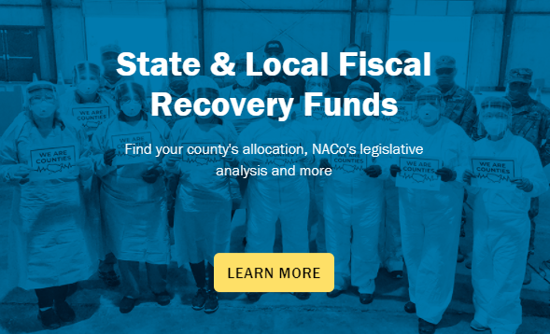
STATE AND LOCAL FISCAL RECOVERY FUNDS
County Allocation: $65.1 billion
Direct, flexible aid to every county in the country
Allocation based on population
State governments may not limit how counties spend funds
Cover costs from March 3, 2021--December 31, 2024 (with exception for premium pay)
Obligated by Dec. 31, 2024
Spent/all work and performance completed by Dec. 31, 2026
Released in two tranches (50 percent each)
National Association of Counties | www.NACo.org | July 2021

Slide 28
AVENUES FOR INVESTING IN SUMMER/AFTERSCHOOL
Serving populations with disproportionate impact from the pandemic (promoting healthy childhood environments)
Revenue loss (specific formula here) funds can include school or educational services
Premium pay for childcare workers, educators or other school staff, including through funds to third-party employers
Grants to nonprofits
National Association of Counties | www.NACo.org | July 2021
National Association of Counties | www.NACo.org | May 2021 | ‹#›

Slide 29
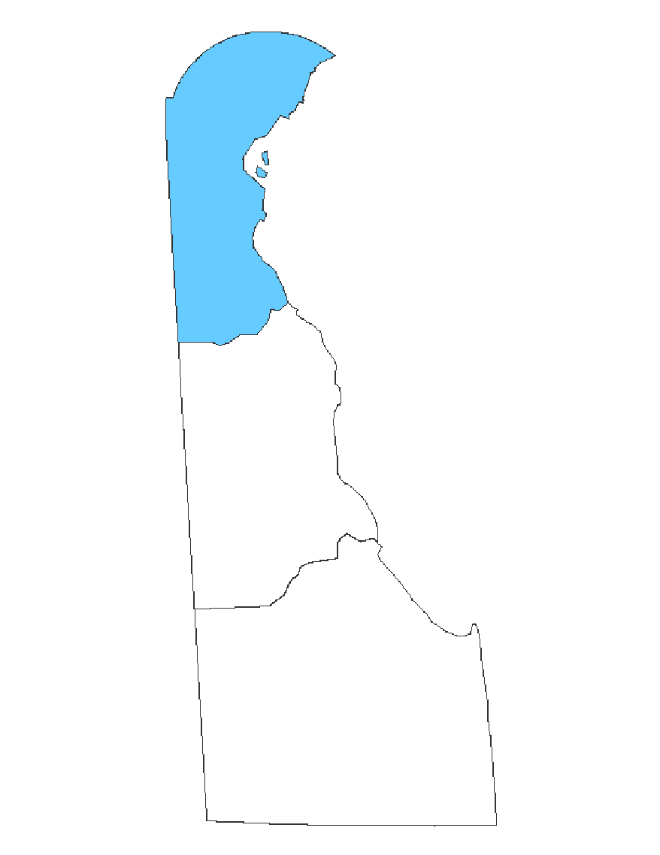
NEW CASTLE COUNTY, DEL.
ALLOCATION: $108.5 M
County executive has proposed $500,000 for urgent summer learning programs
Would involve collaboration with the Red Clay Freedom School, which provides summer and afterschool enrichment to support K-12 students, and Reading Assist, which provides intensive services for at-risk children facing reading challenges
New Castle County will have task force committees that will recommend investments to the County, drawing on community feedback
National Association of Counties | www.NACo.org | July 2021

Slide 30
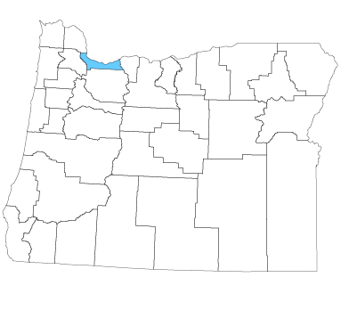
MULTNOMAH COUNTY, ORE.
ALLOCATION: $157.9 M
$5.4 million for wrap-around supports for youth and families, including enhanced funding for the Schools Uniting Neighborhood (SUN) Community Schools program to provide enrichment and learning during the summer
Learn more here
National Association of Counties | www.NACo.org | July 2021

Slide 31
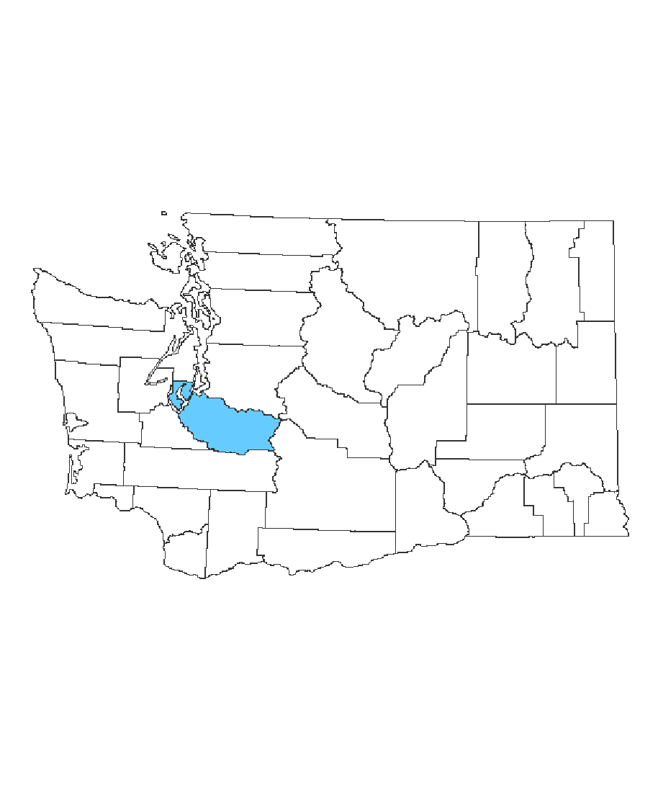
PIERCE COUNTY, WASH.
ALLOCATION: $175.8 M
$1.5 million for expanding summer youth programs
$2 million to focus on youth employment in the Washington Service Corps
Learn more here
National Association of Counties | www.NACo.org | July 2021

Slide 32
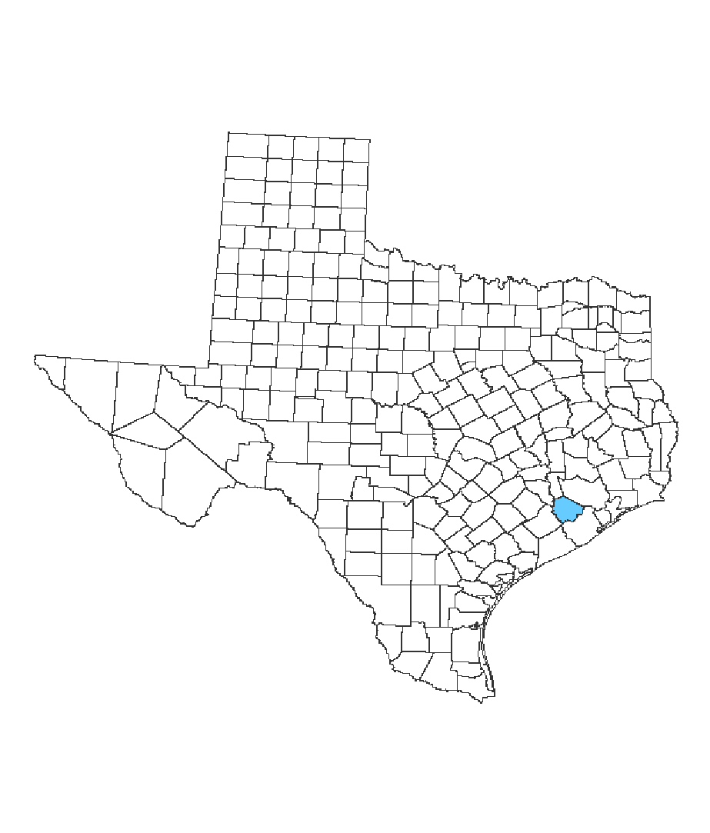
FORT BEND COUNTY, TEXAS
ALLOCATION: $157.6 M
$3 million for a summer youth jobs program
The Youth Employment Program is open to people 16 to 21 years old and will place them in positions in 37 county departments, including the Fort Bend County sheriff's office, behavioral health services, commissioner offices, county clerk, county judge, district attorney, fire marshal, homeland security and emergency management
Learn more here
National Association of Counties | www.NACo.org | July 2021

Slide 33
CONSIDERATIONS FOR LOCAL STAKEHOLDERS
County boards as key decision-makers
Use opportunities to provide community feedback
Coordinate with other key stakeholders receiving COVID relief dollars (track funds here)
Long-term vs. short-term investments—must be able to link back to COVID-19 pandemic
National Association of Counties | www.NACo.org | July 2021
National Association of Counties | www.NACo.org | May 2021 | ‹#›

Slide 34
Questions and Answers
Thank you for joining!
Resources, slides, answers to questions we didn’t get to today, and presenter bios can be found on the
Afterschool Alliance webinar registration page
Email: Erik Peterson epeterson@afterschoolalliance.org
Notes:
http://www.afterschoolalliance.org/webinars.cfm?ID=6DE770F0-5056-A82E-7A690AD8A6C1616D

Slide 35
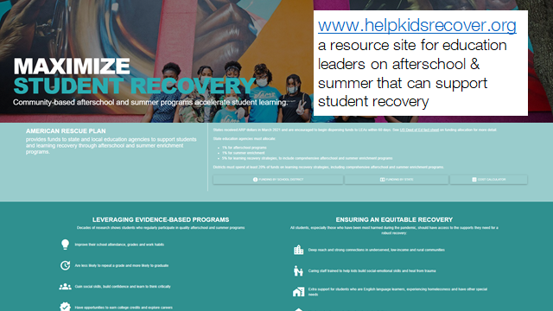
Notes:
https://www.helpkidsrecover.org/

