Slide 1
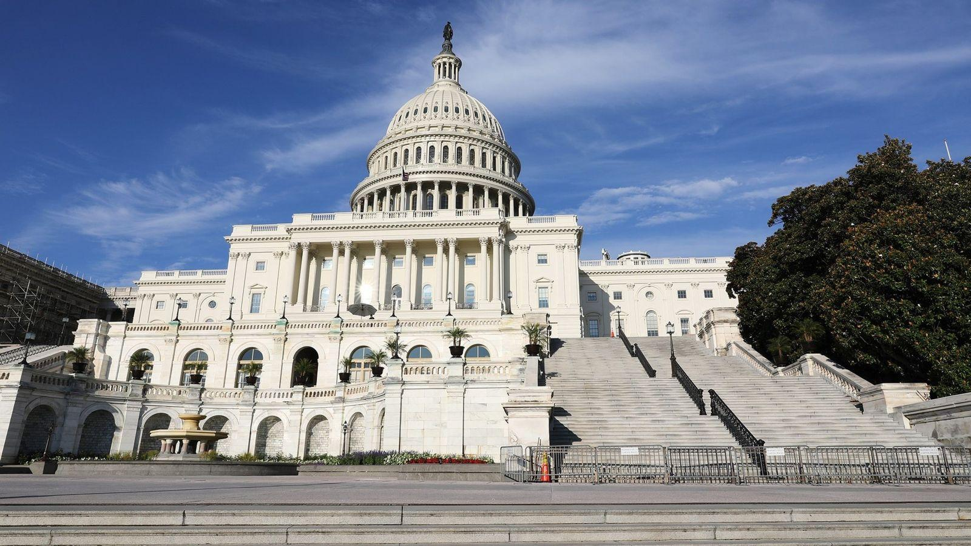
Policy Pulse
Friday, August 8, 2025

Slide 2
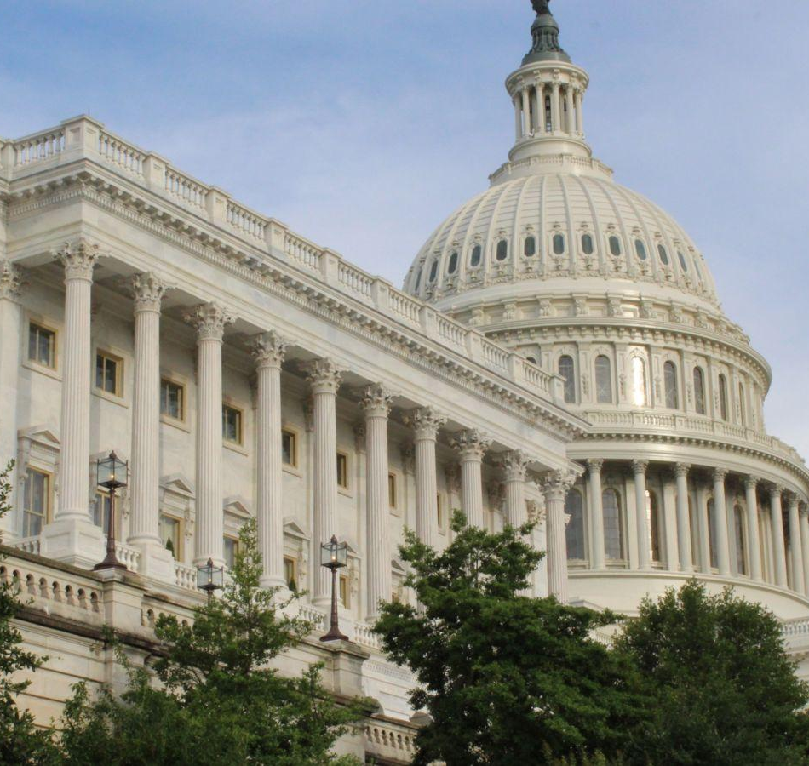
Housekeeping
This conversation is being shared on YouTube, Facebook, and LinkedIn
Have questions? We’ll answer! Please ask your question via our Google Form and we’ll address them via email or on next month’s broadcast

Slide 3

Today’s Agenda
FY25 Funding
  21st CCLC funding released July 21st
  Remaining education title funds released July 25th
  AmeriCorps and Youth Mentoring grants still withheld
FY26 Funding
  Senate maintains funding in FY26 Appropriations bill
  What’s next
Site Visits!

Slide 4


Slide 5
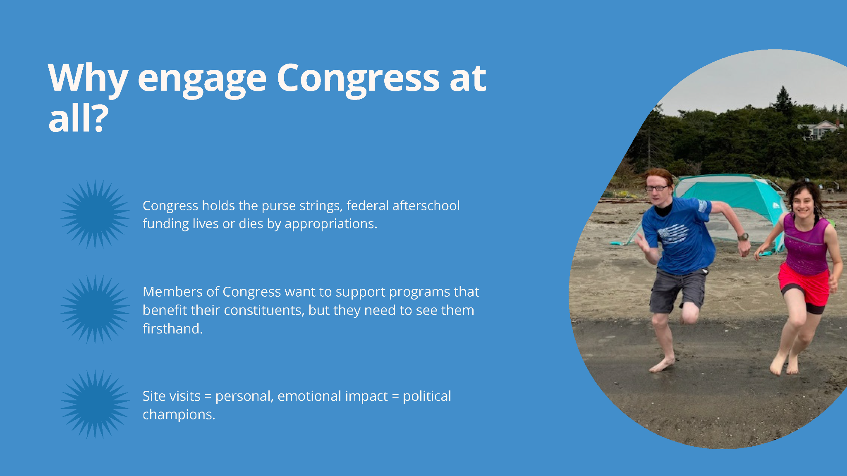

Slide 6
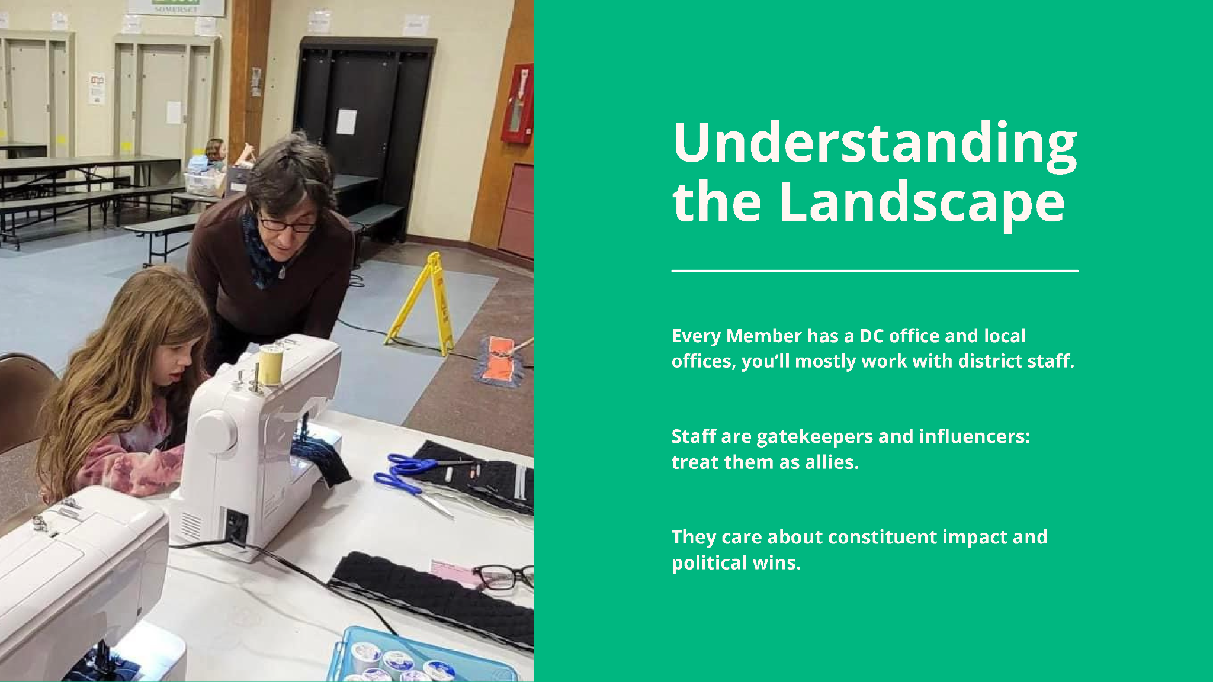
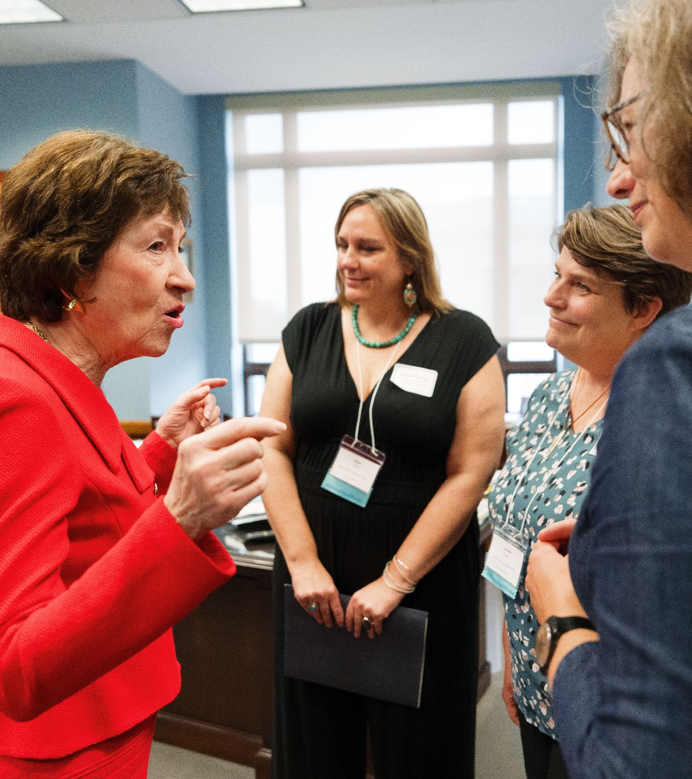

Slide 7


Slide 8
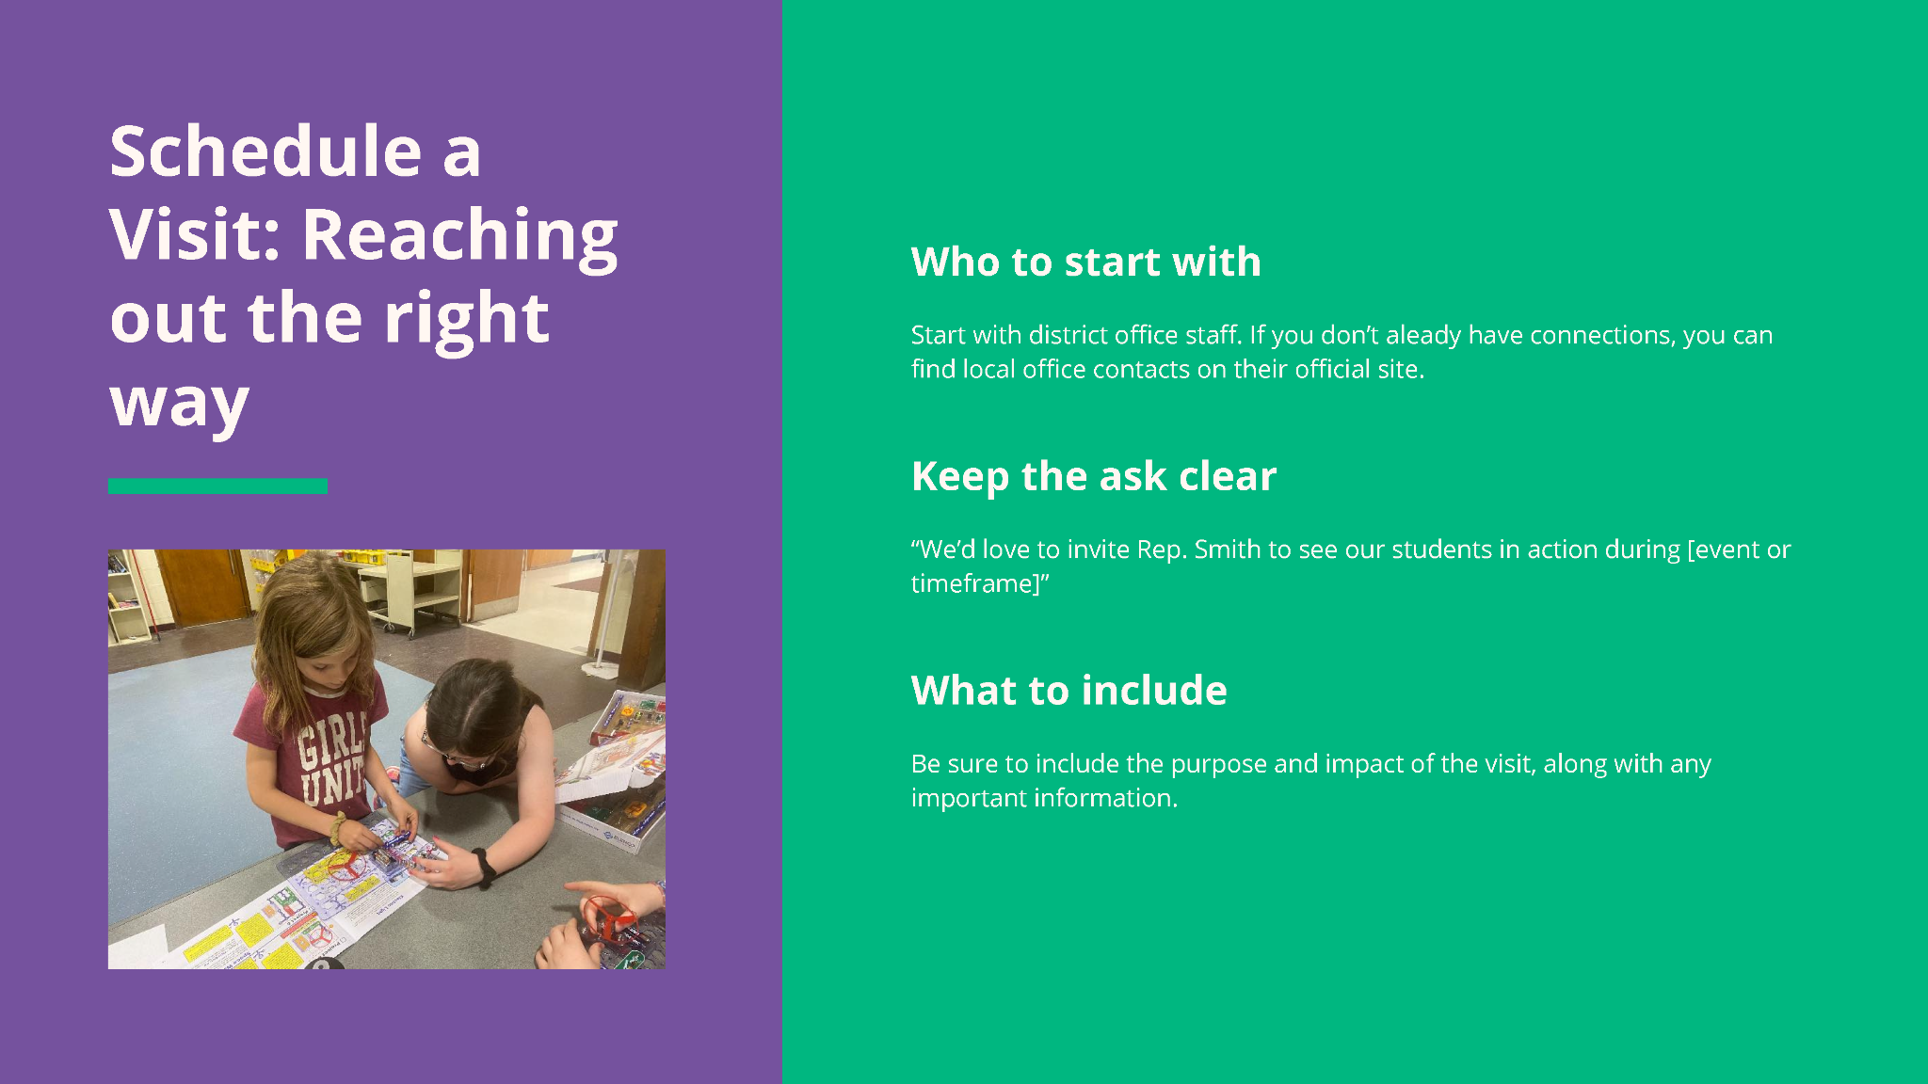

Slide 9


Slide 10
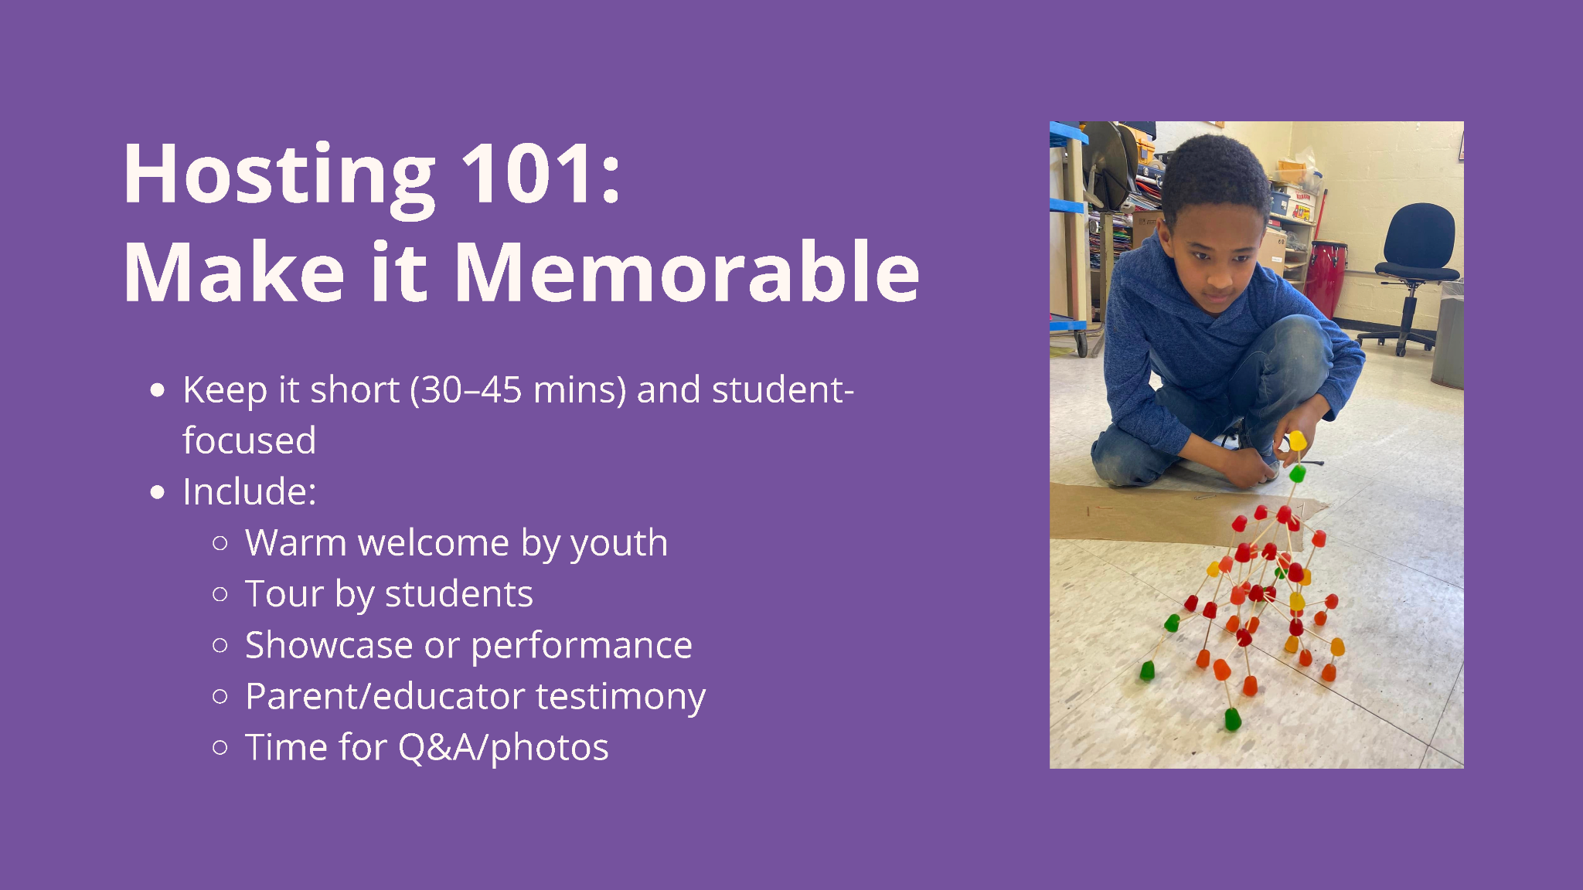

Slide 11
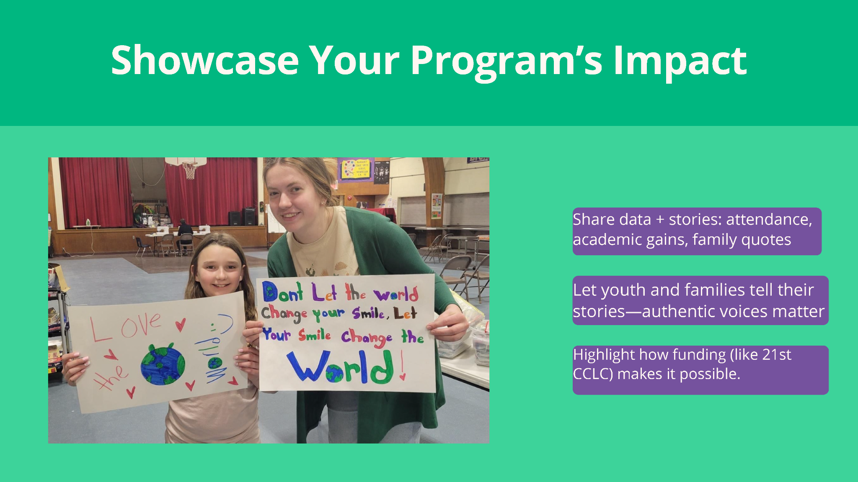
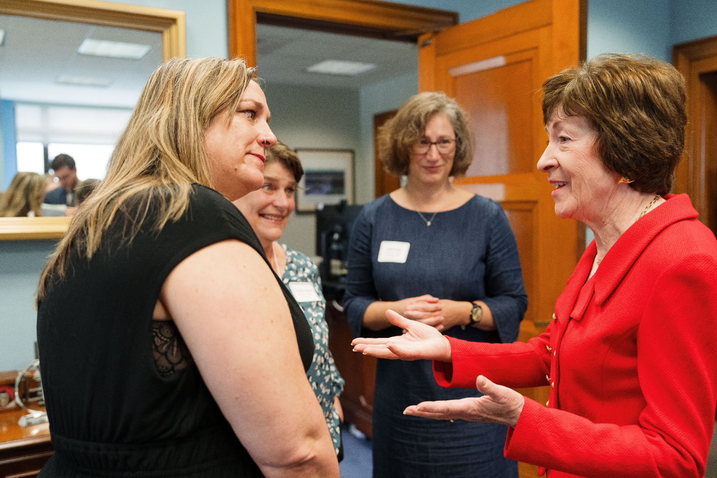

Slide 12


Slide 13
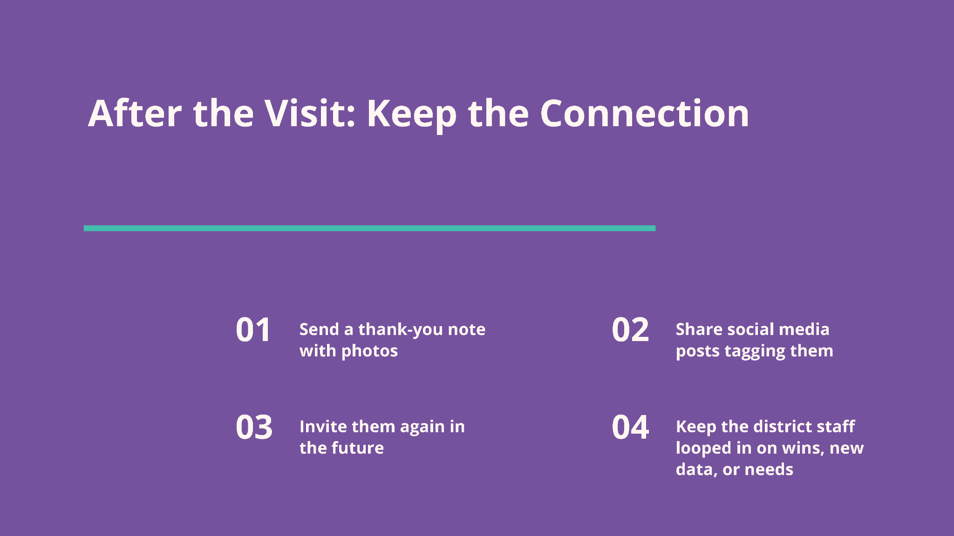

Slide 14
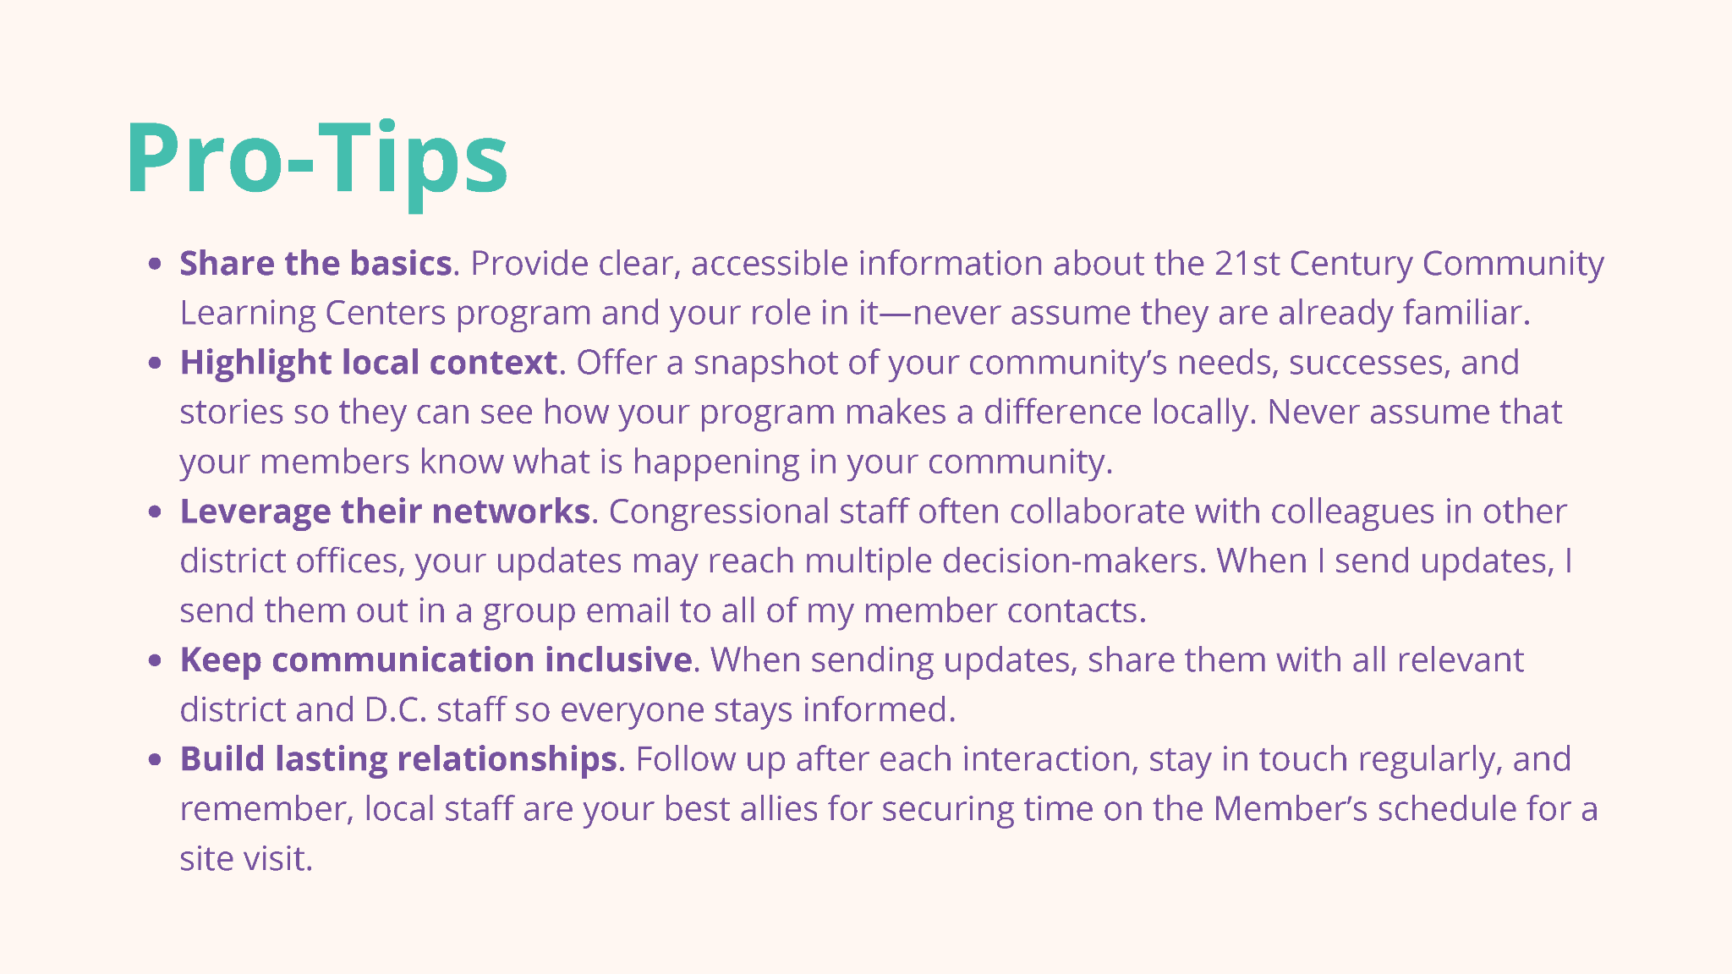

Slide 15
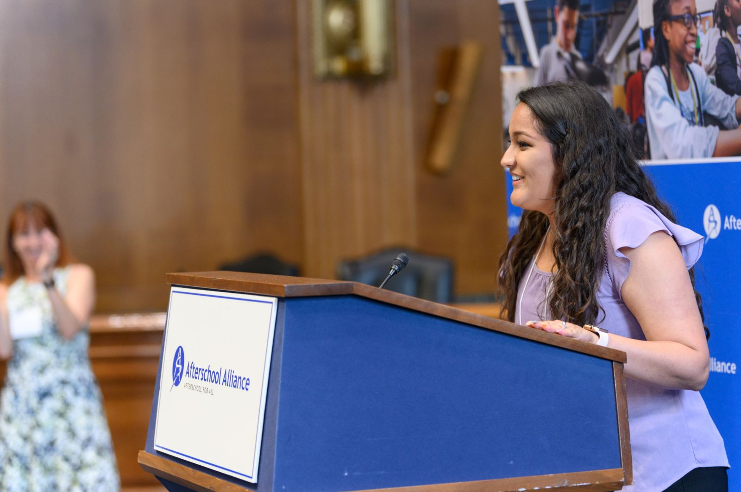

Urge Congress to fund afterschool
Use your home address to find your policymakers
3to6.co/congress

Slide 16


Lights On Afterschool is open
3to6.co/lightson

Slide 17


Get our news and policy
updates
3to6.co/updates

