Slide 1
App Schedules and Logistics Overview

Slide 2
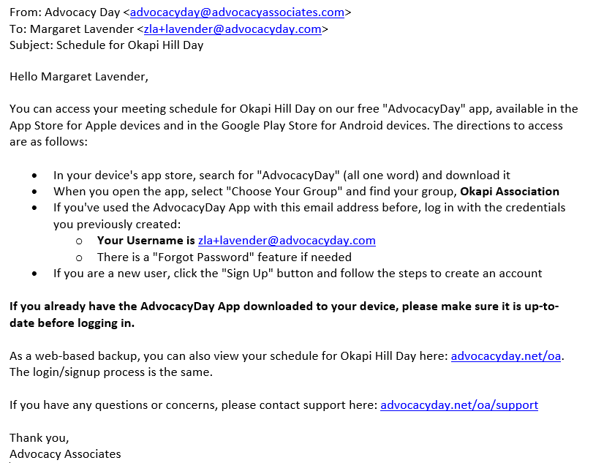
Downloading the App
You will receive an automated email from Advocacy Associates on a to-be-determined date by your organization
Check your SPAM/JUNK folder if you think you did not receive the email
Verify with your organization on the date this email was/will be sent

Slide 3
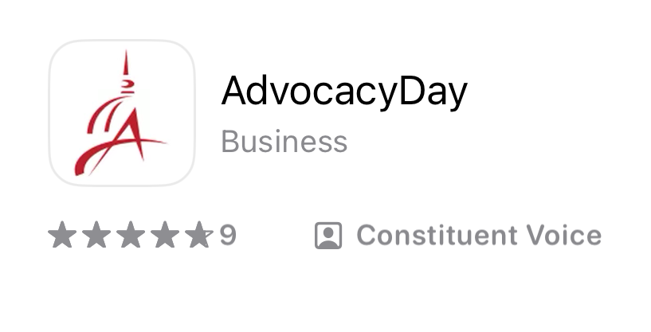
Downloading the App
You will receive an automated email from Advocacy Associates on a to-be-determined date by your organization
Check your SPAM/JUNK folder if you think you did not receive the email
Verify with your organization on the date this email was/will be sent
Follow the instructions to download the app

Slide 4
Downloading the App
You will receive an automated email from Advocacy Associates on a to-be-determined date by your organization
Check your SPAM/JUNK folder if you think you did not receive the email
Verify with your organization on the date schedules were/will be sent
Follow the instructions to download the app
Contact us for any technical support

Slide 5
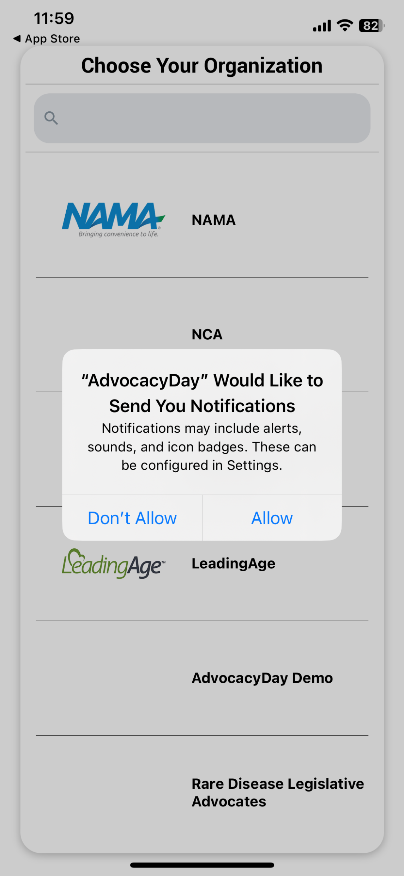
When Opening the App
Select “Allow” for notifications

Slide 6
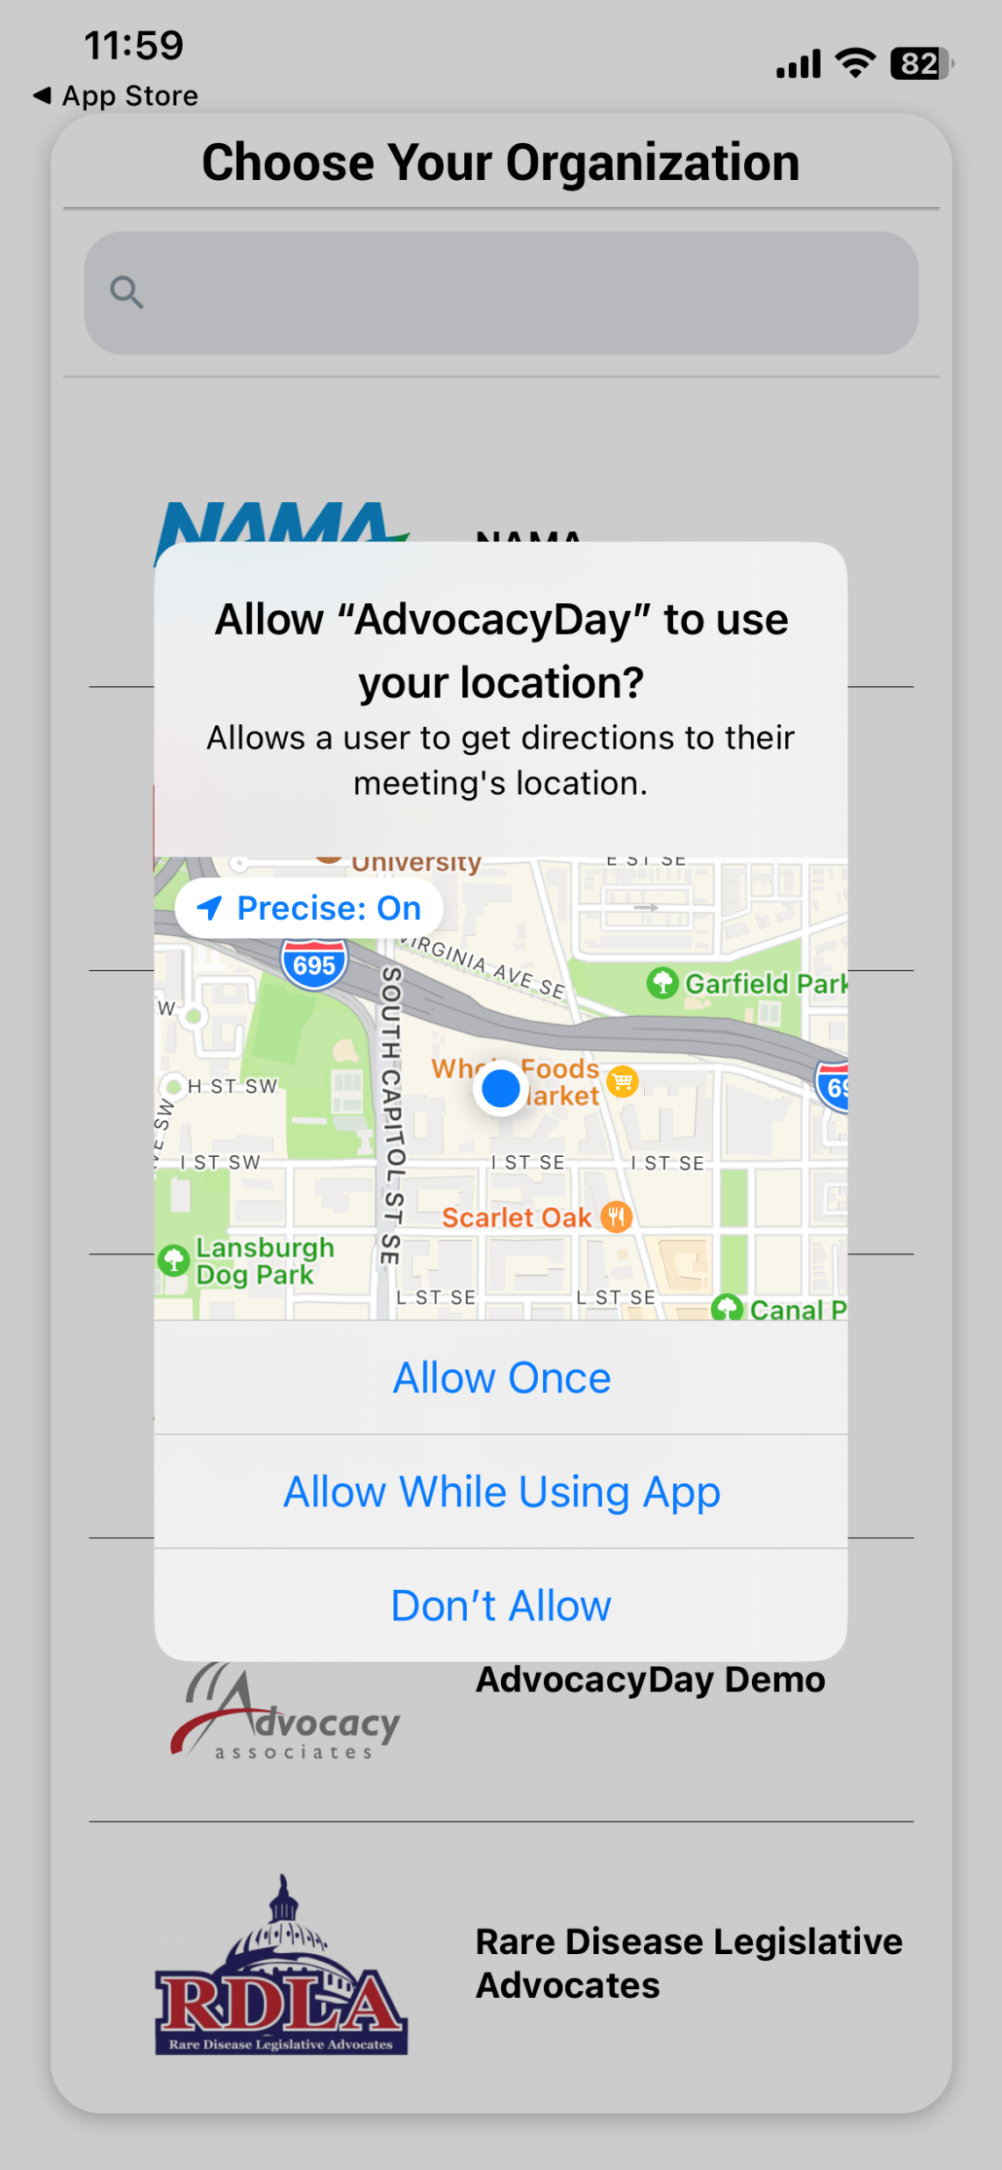
When Opening the App
Select “Allow” for notifications
Select “Allow While Using App” for location setting

Slide 7
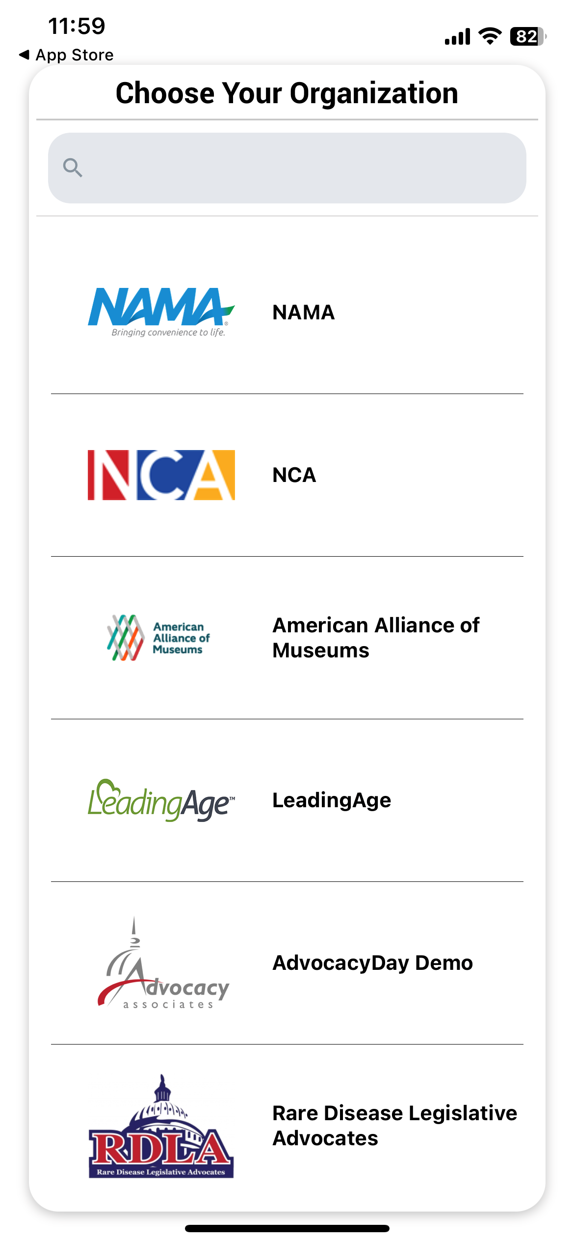
When Opening the App
Select “Allow” for notifications
Select “Allow While Using App” for location setting
Type your organization’s name in the Search bar at the top

Slide 8
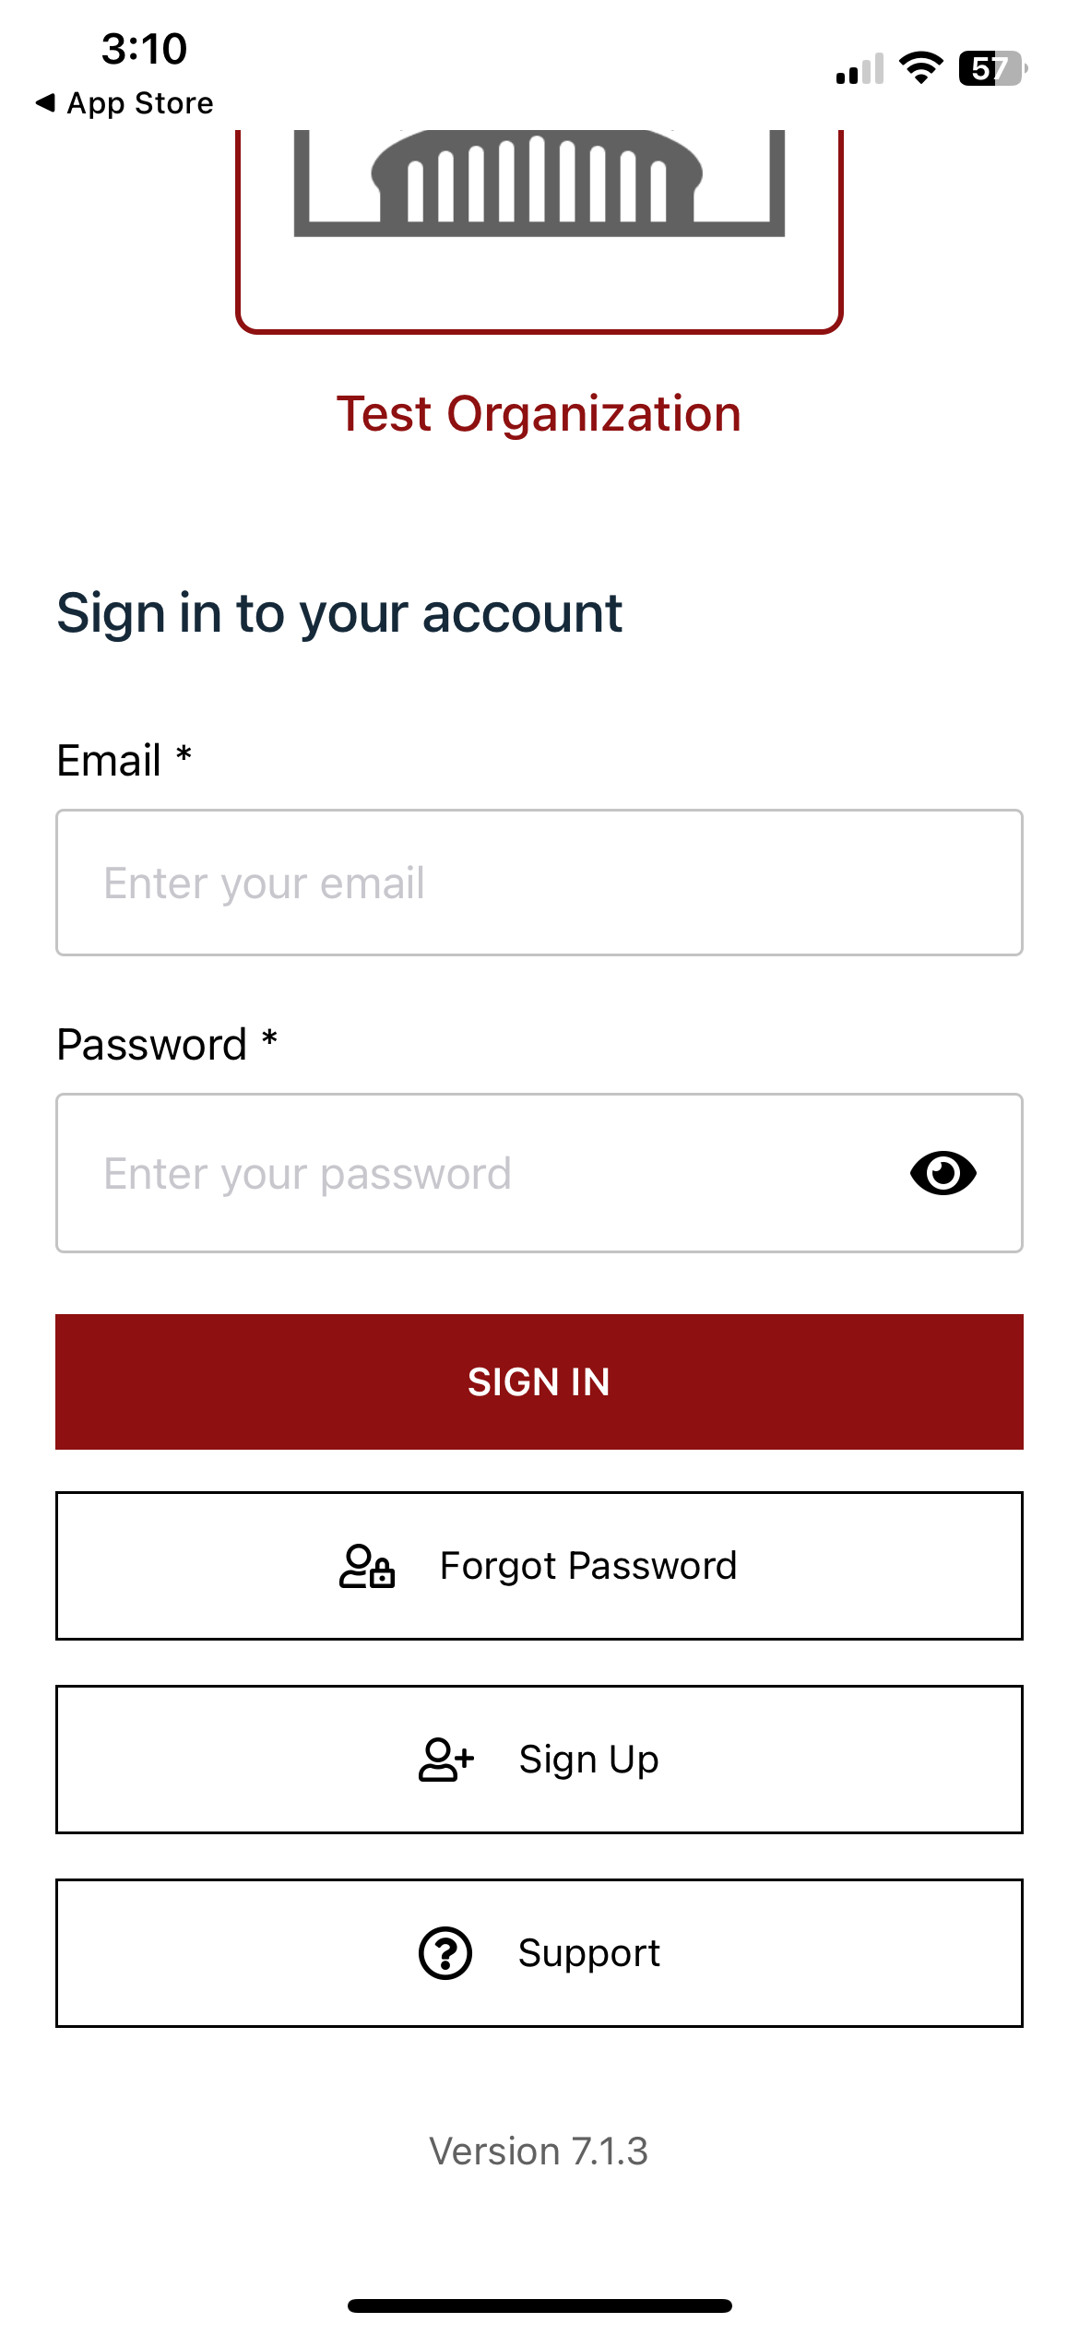
Logging In
FIRST TIME users will need to Sign Up

Slide 9
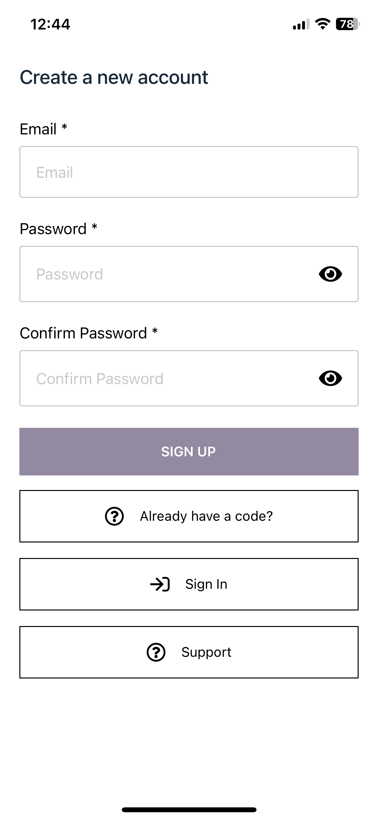
Logging In
FIRST TIME users will need to Sign Up
Enter your email and create a password. Tap “Sign Up” when finished

Slide 10
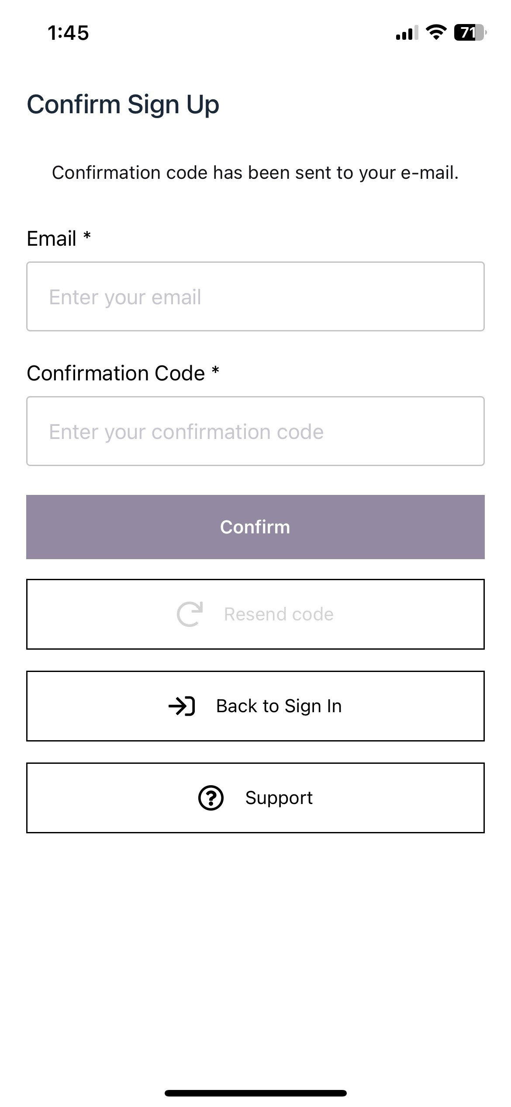
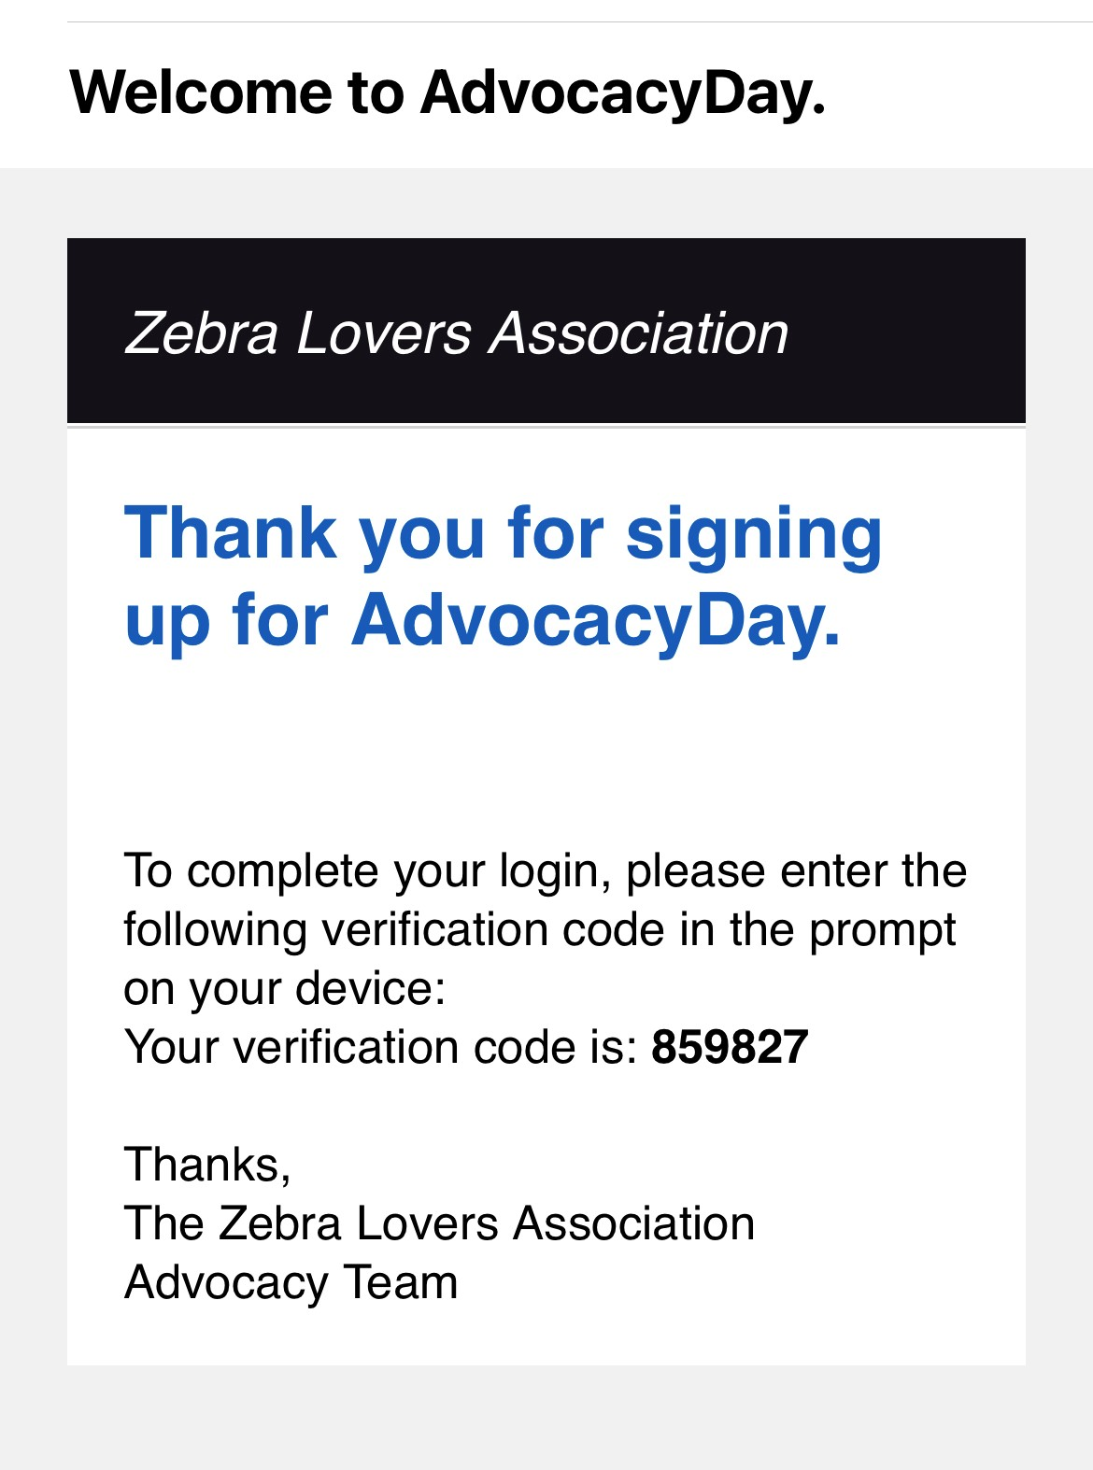
Logging In
FIRST TIME users will need to Sign Up
Enter your email and create a password. Tap “Sign Up” when finished
Check your email for a verification code. Input your email and the code. Tap “Confirm”

Slide 11
Logging In
FIRST TIME users will need to Sign Up
Enter your email and create a password. Tap “Sign Up” when finished
Check your email for a verification code. Input your email and the code. Tap “Confirm”
Login with your newly created credentials

Slide 12
Logging In
FIRST TIME users will need to Sign Up
Enter your email and create a password. Tap “Sign Up” when finished
Check your email for a verification code. Input your email and the code. Tap “Confirm”
Login with your newly created credentials
Contact support for any issues

Slide 13
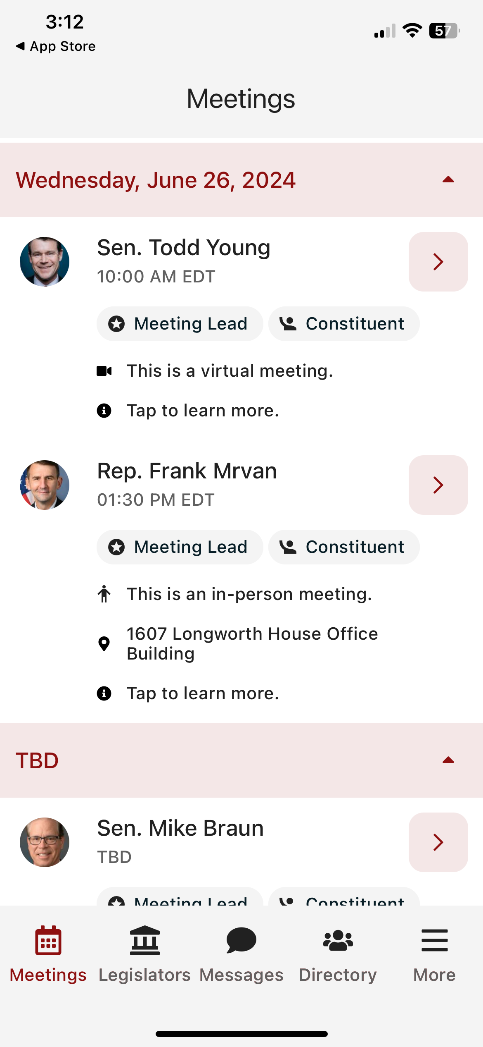
Main Schedule Page
Confirmed meetings display with a time, pending meetings display as TBD

Slide 14
Main Schedule Page
Confirmed meetings display with a time, pending meetings display as TBD
All times displayed in time zone you are located in

Slide 15
Main Schedule Page
Confirmed meetings display with a time, pending meetings display as TBD
All times displayed in time zone you are located in
Badges indicating if you are a Constituent and/or Meeting Lead for that meeting

Slide 16
Main Schedule Page
Confirmed meetings display with a time, pending meetings display as TBD
All times displayed in time zone you are located in
Badges indicating if you are a Constituent and/or Meeting Lead for that meeting
Tap anywhere on the meeting to learn more

Slide 17
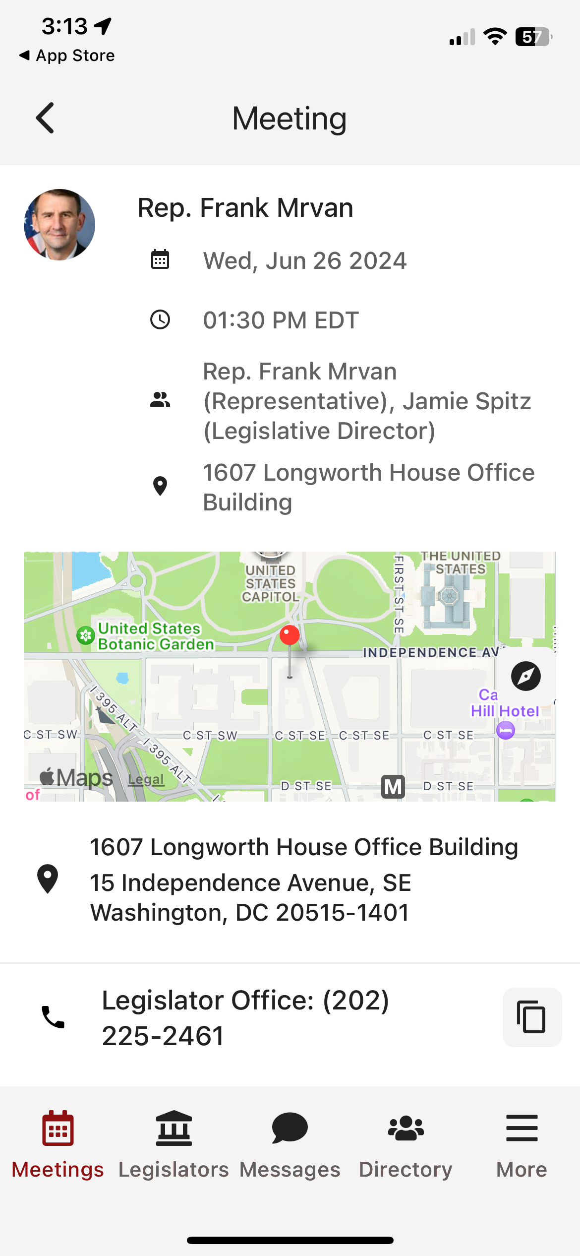
Date/Time/Meeting With/Location

Slide 18
Date/Time/Meeting With/Location
Tap on the map to get walking directions to the building

Slide 19
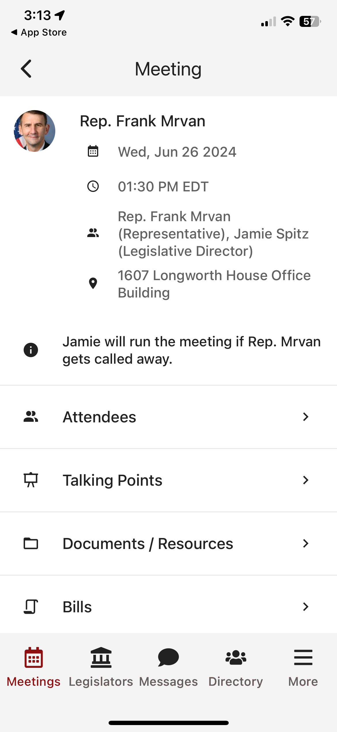
Date/Time/Meeting With/Location
Tap on the map to get walking directions to the building
Scroll down for any important information

Slide 20
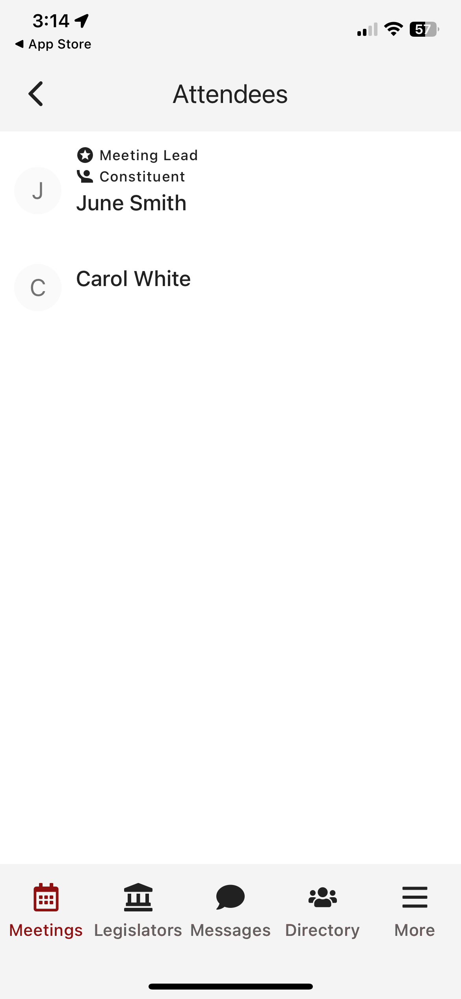
Date/Time/Meeting With/Location
Tap on the map to get walking directions to the building
Scroll down for any important information
Attendees in the meeting

Slide 21
Date/Time/Meeting With/Location
Tap on the map to get walking directions to the building
Scroll down for any important information
Attendees in the meeting
Talking points

Slide 22
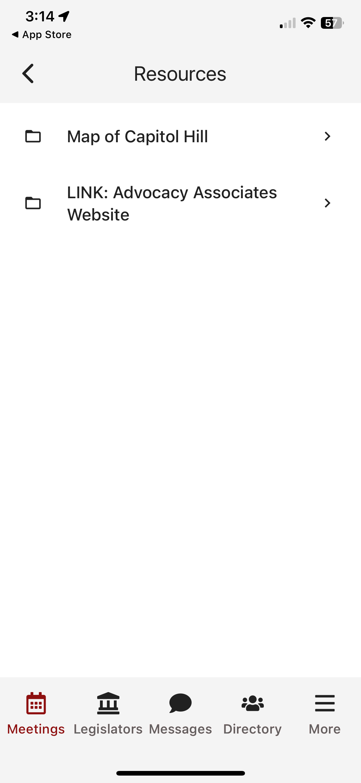
Date/Time/Meeting With/Location
Tap on the map to get walking directions to the building
Scroll down for any important information
Attendees in the meeting
Talking points
Documents and resources

Slide 23
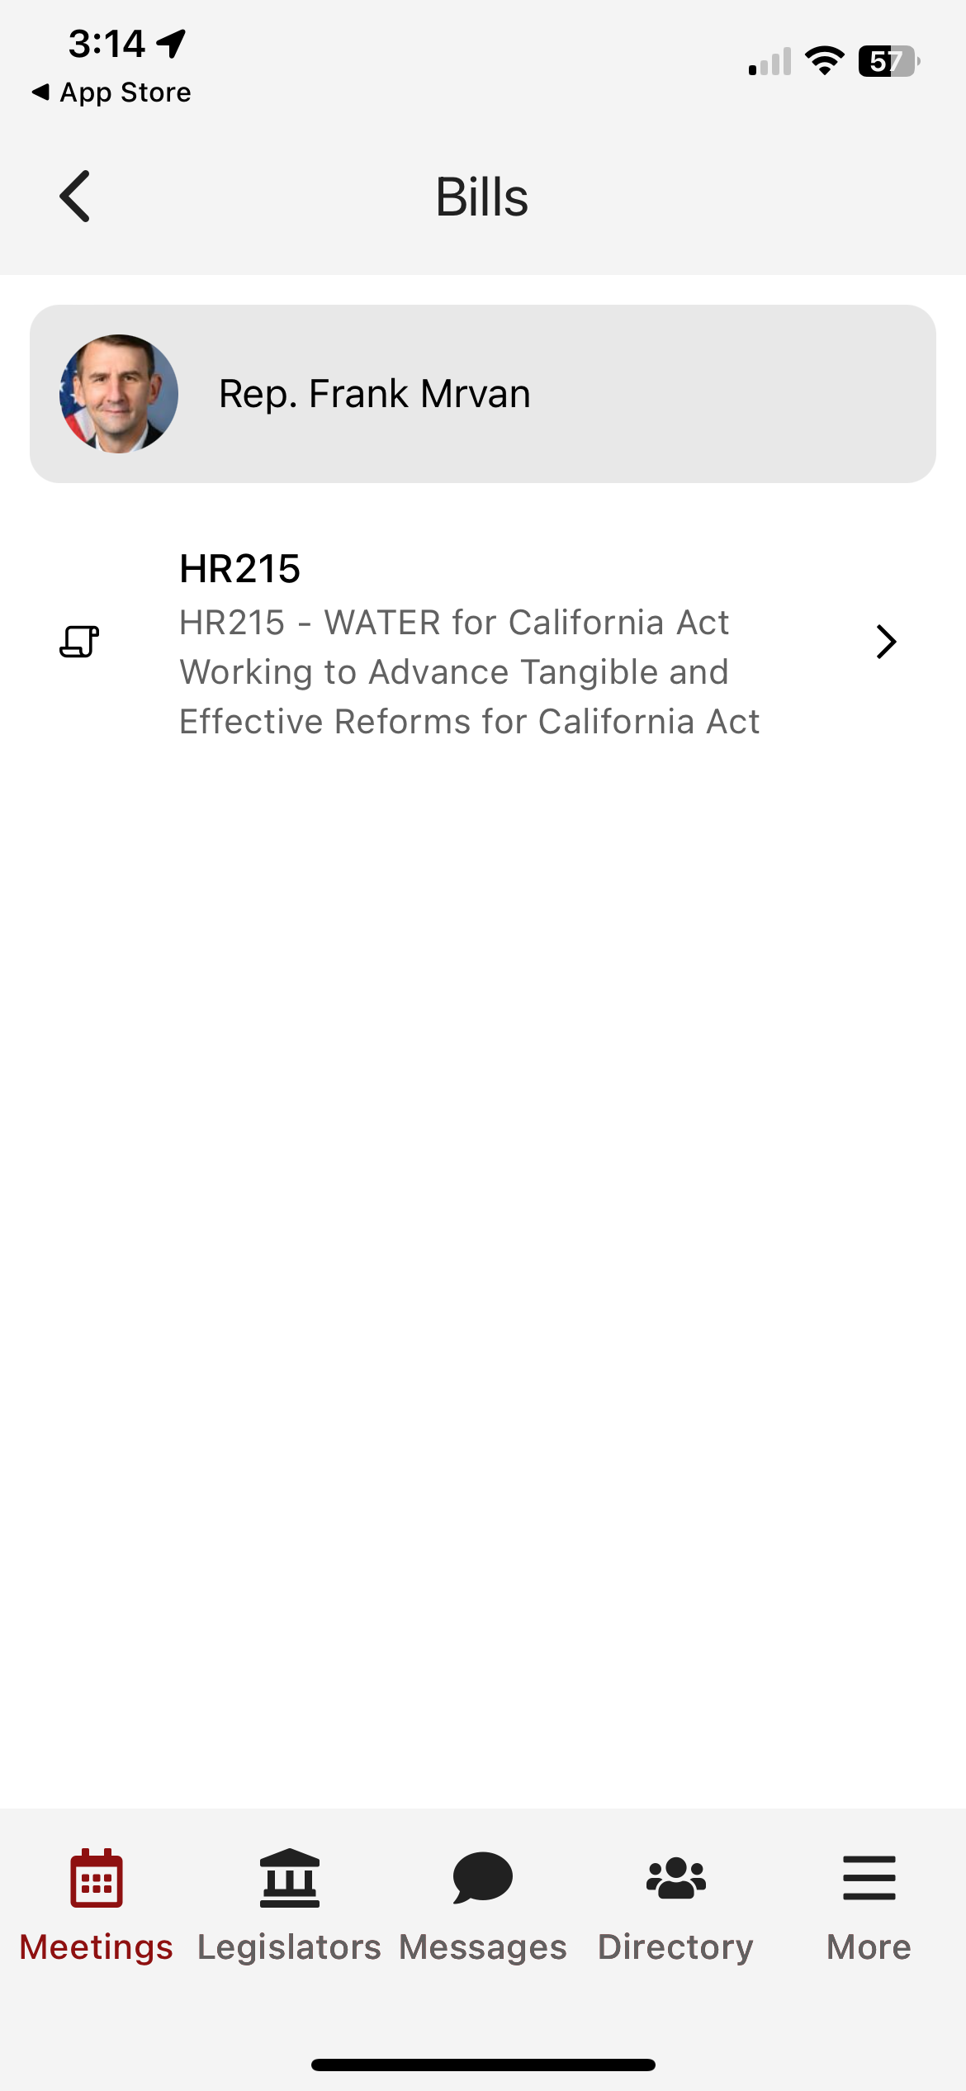
Date/Time/Meeting With/Location
Tap on the map to get walking directions to the building
Scroll down for any important information
Attendees in the meeting
Talking points
Documents and resources
Bills

Slide 24
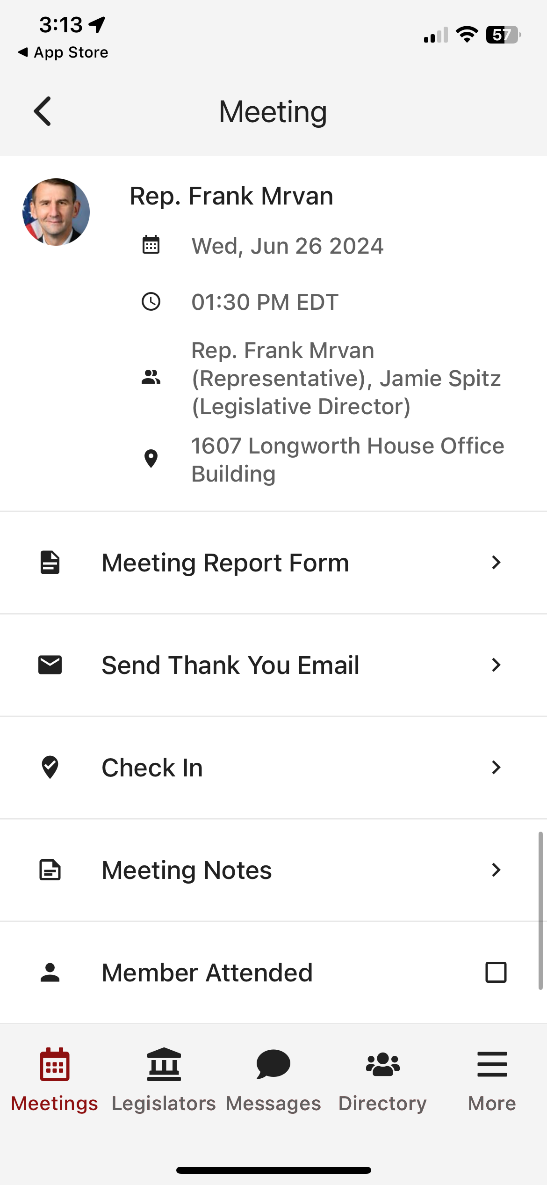
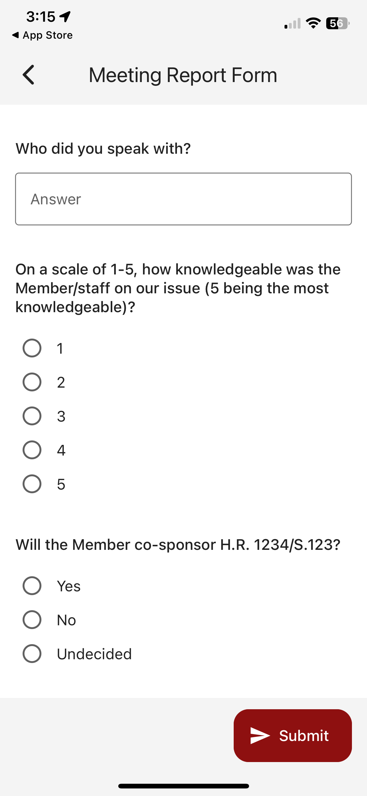
Date/Time/Meeting With/Location
Tap on the map to get walking directions to the building
Scroll down for any important information
Attendees in the meeting
Talking points
Documents and resources
Bills
Meeting report form

Slide 25
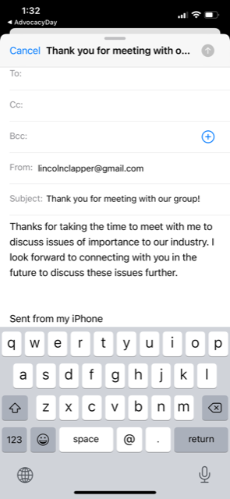
Date/Time/Meeting With/Location
Tap on the map to get walking directions to the building
Scroll down for any important information
Attendees in the meeting
Talking points
Documents and resources
Bills
Meeting report form
Thank you email

Slide 26
Date/Time/Meeting With/Location
Tap on the map to get walking directions to the building
Scroll down for any important information
Attendees in the meeting
Talking points
Documents and resources
Bills
Meeting report form
Thank you email
Check in to report attendance

Slide 27
Date/Time/Meeting With/Location
Tap on the map to get walking directions to the building
Scroll down for any important information
Attendees in the meeting
Talking points
Documents and resources
Bills
Meeting report form
Thank you email
Check in to report attendance
Take meeting notes

Slide 28
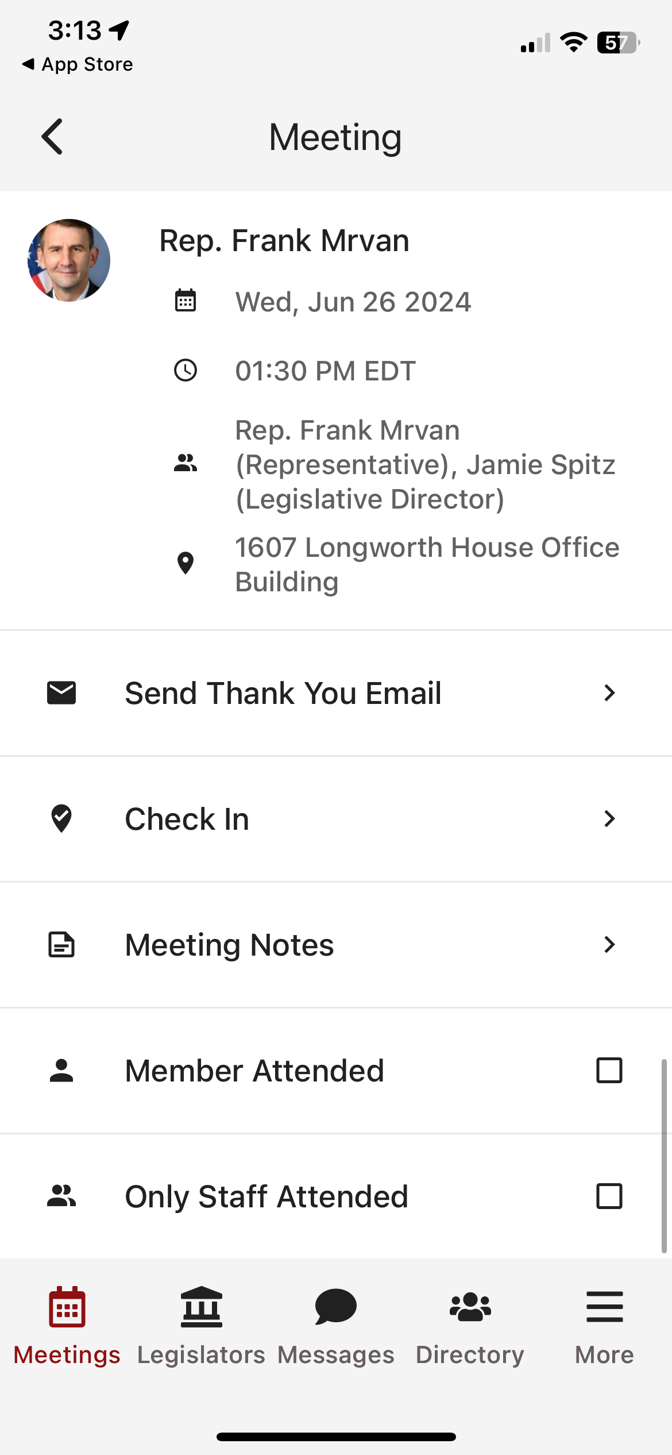
Date/Time/Meeting With/Location
Tap on the map to get walking directions to the building
Scroll down for any important information
Attendees in the meeting
Talking points
Documents and resources
Bills
Meeting report form
Thank you email
Check in to report attendance
Take meeting notes
Did the Member of Congress attend?

Slide 29
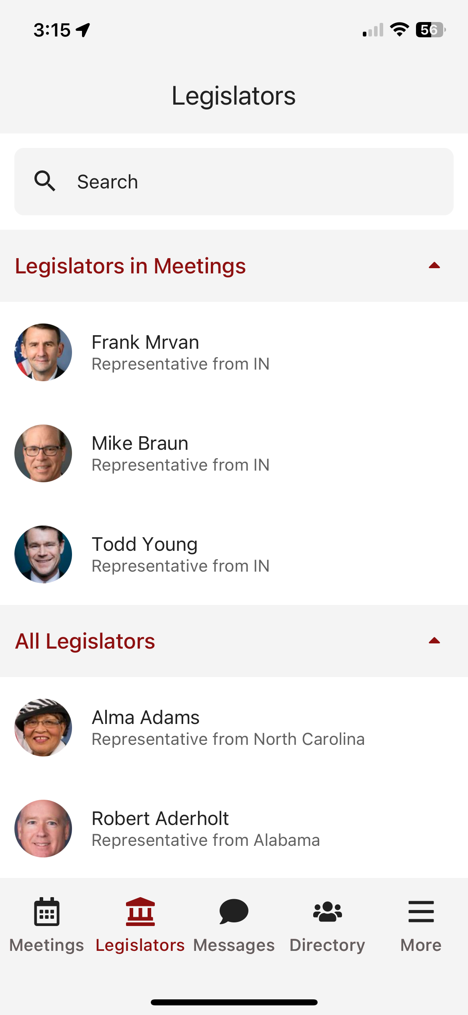
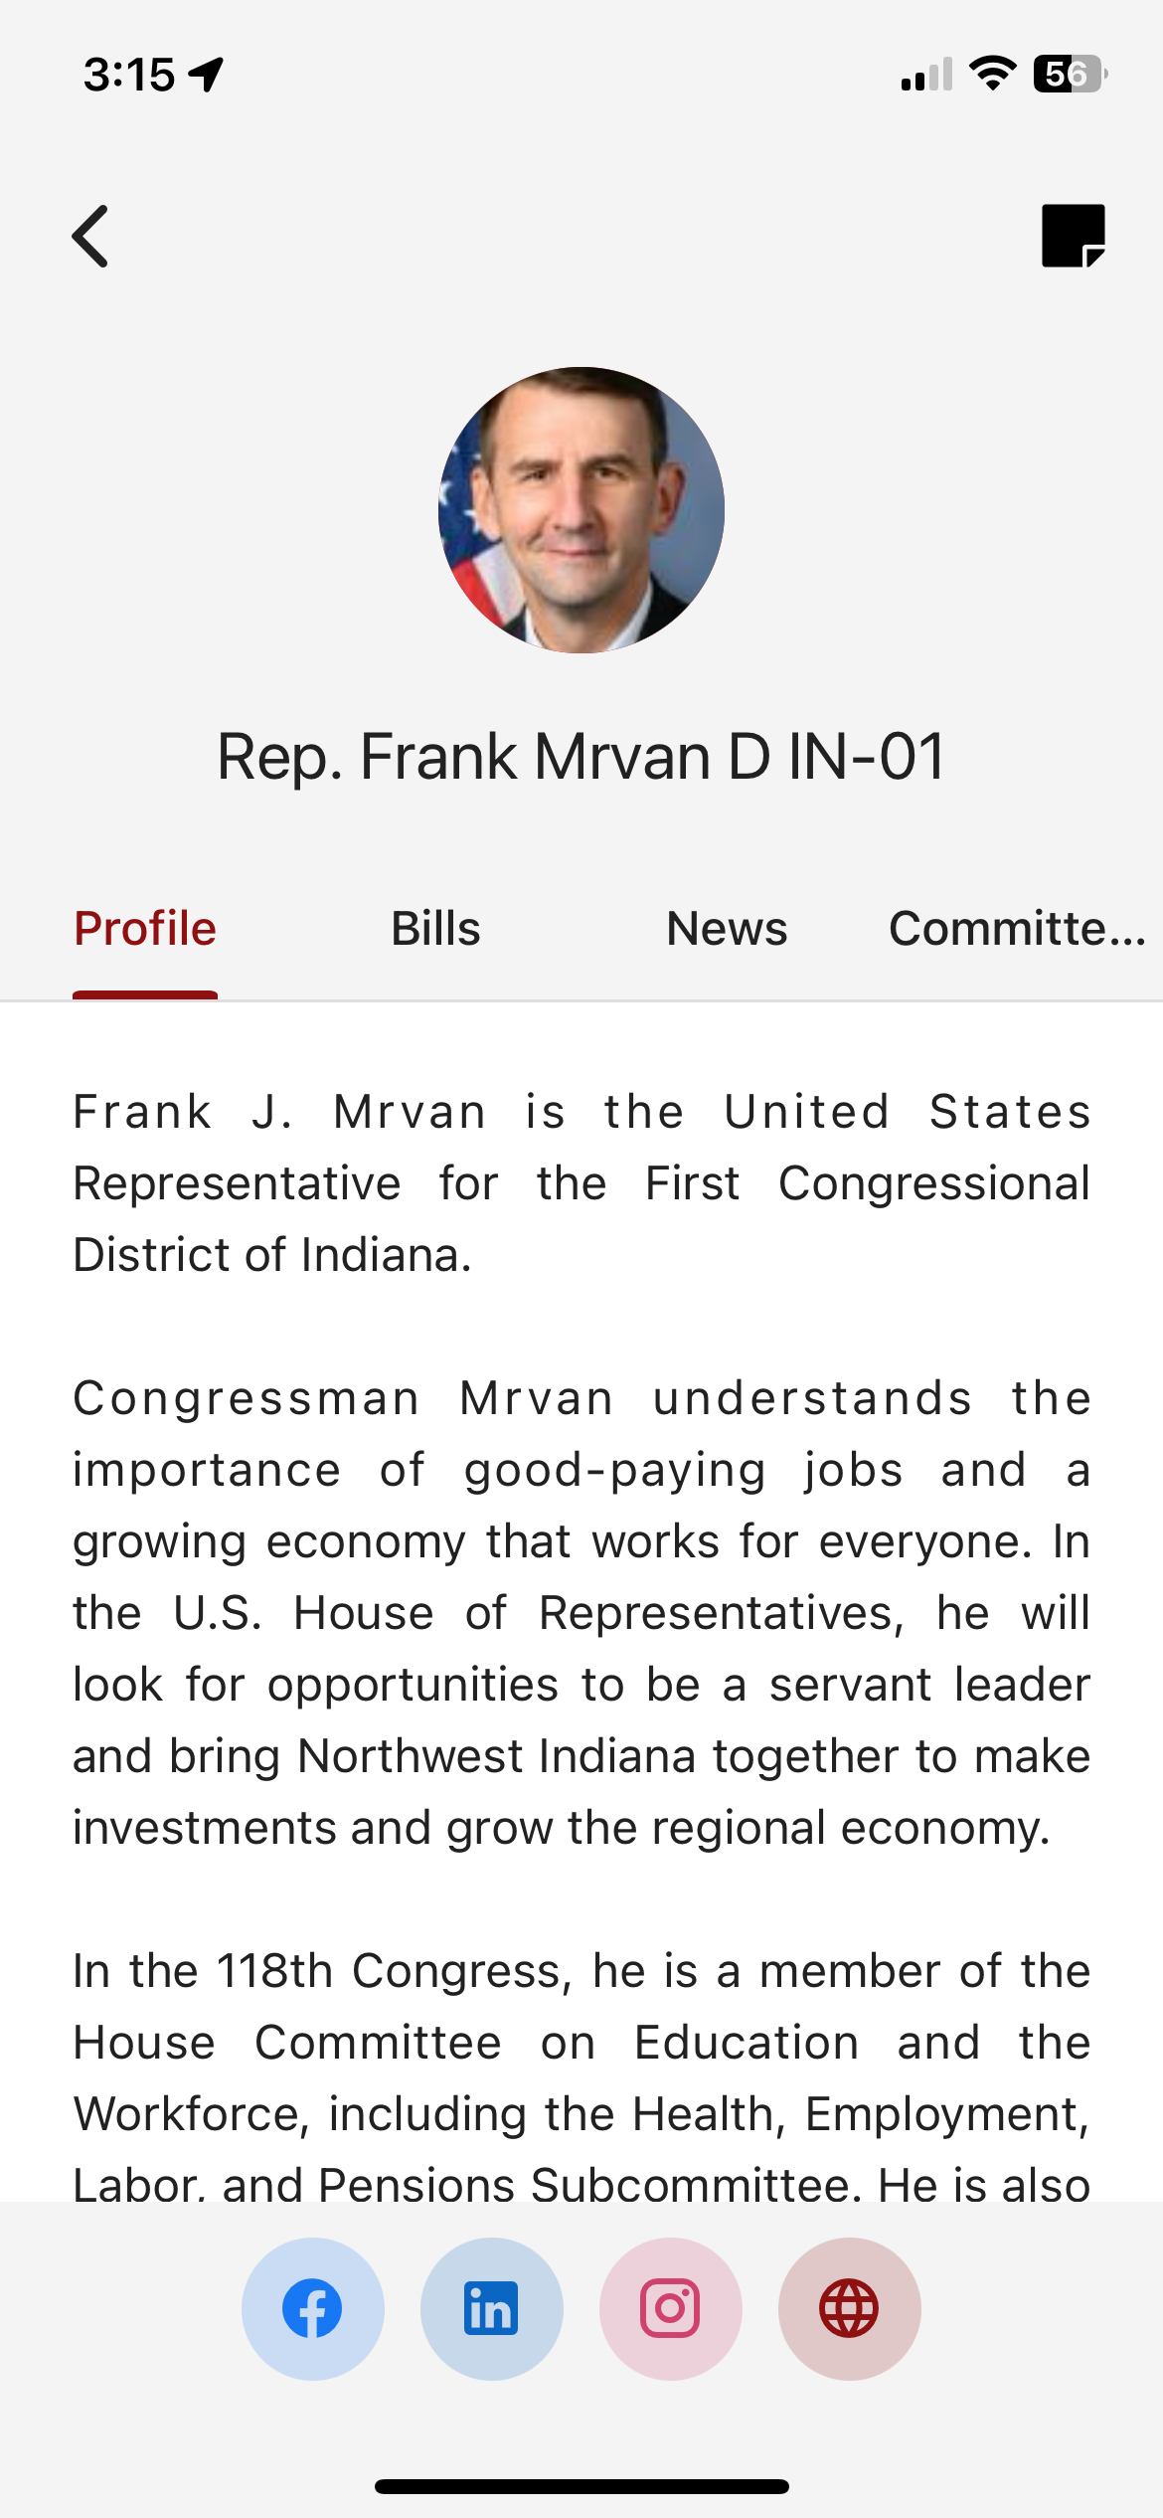
Legislators tab, tap on each for a biography

Slide 30
Legislators tab, tap on each for a biography
Relevant bills with voting record, recent news mentions, committee assignments

Slide 31
Legislators tab, tap on each for a biography
Relevant bills with voting record, recent news mentions, committee assignments
Messages tab to highlight any updates. You will also receive updates via push notification and email

Slide 32
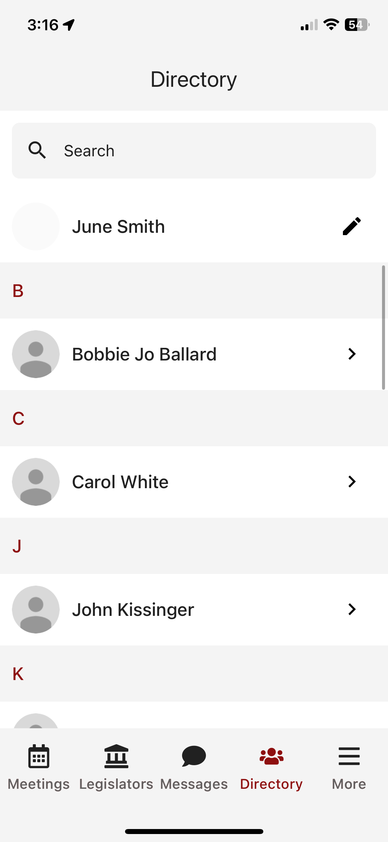
Legislators tab, tap on each for a biography
Relevant bills with voting record, recent news mentions, committee assignments
Messages tab to highlight any updates. You will also receive updates via push notification and email
Directory to look up attendees in your event. Tap to get more information

Slide 33
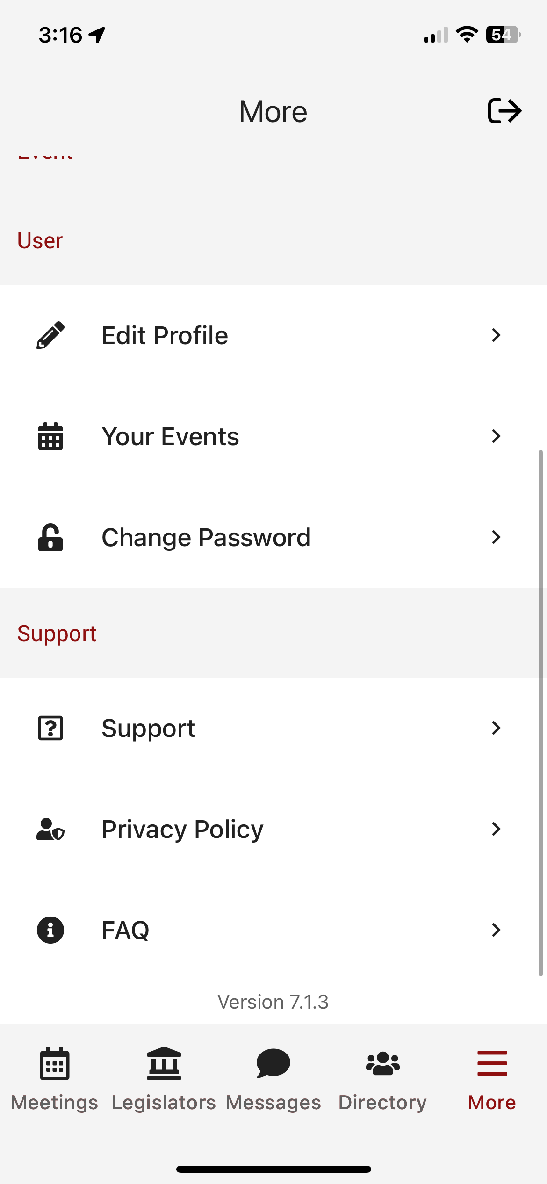
Legislators tab, tap on each for a biography
Relevant bills with voting record, recent news mentions, committee assignments
Messages tab to highlight any updates. You will also receive updates via push notification and email
Directory to look up attendees in your event. Tap to get more information
More tab for additional resources, importantly all SUPPORT and FAQs

Slide 34
Relevant Information and Reminders
Check your SPAM/JUNK folder to ensure you didn’t miss the initial email (domain is @advocacyassociates.com)
Give yourself 30 minutes to get through security and navigate your way to the office
All times will be displayed in the time zone you are located in
There will be a help number listed in the Support tab to call if you need to get ahold of Advocacy Associates
Meetings may last anywhere from 15-30 minutes, prepare your pitch and talking points accordingly. ASK how much time the office has
Any changes to your schedule the day of the event will be sent to you via push notification and email. Please be sure to check regularly throughout the day. Updates will also be flagged in the Messages tab in your app

Slide 35
App Schedules and Logistics Overview

